Slide 1
Anything but simple.
Gina Nichols
PhD Defense
Crop Physiology
August 25 2021

Slide 2
2018-present
Nichols et al. (in prep) Roots as drivers of the rotation effect in maize?
Nichols et al. (in prep) Using models to unravel causal mechanisms of the continuous maize penalty
Nichols & MacKenzie (in prep) Decision analysis to target cover crop research priorities in Central Iowa
Nichols et al. (in review) Winter cover cropping effects on soil water storage vary by site: Field measurements and a proposed causal model
Nichols et al. (2020). Effect of long-term cover-cropping on weed seedbanks. Frontiers in Agronomy
Nichols et al. (2020) Cover crops and weed suppression in the U.S. Midwest: A meta‐analysis and modeling study. Agricultural and Environmental Letters
Weisberger*, Nichols*, Liebman (2019) Does diversifying crop rotations suppress weeds? A meta-analysis. PloS one
Nichols et al. (2019) Maize root distributions strongly associated with water tables in Iowa, USA Plant and Soil
Bird, Nichols, et al. (in review). Means, motive, and opportunity: A stakeholder analysis method to understand likelihood of action in food-energy-water systems. Elementa
Pasley, Nichols, et al. (2021). Rotating maize reduces the risk and rate of nitrate leaching. Environmental Research Letters.
Archontoulis, Castellano, Licht, Nichols, et al. (2020) Predicting crop yields and soil-plant nitrogen dynamics in the US Corn Belt. Crop Science
Liebman & Nichols (2020) Cropping system redesign for improved weed management: A modeling approach illustrated with giant ragweed (Ambrosia trifida). Agronomy
Martinez-Feria, Nichols, et al. (2019) Can multi-strategy management stabilize nitrate leaching under increasing rainfall? Environmental Research Letters
Notes:
I arrived at ISU in January 2018. On the left are my first-authored publications, and on the right my co-authored publications since I’ve arrived. I’m showing you this to tell you I have a lot of things I’ve done that I want to tell you about. But I can’t.
So I made a short list of some of the key take-aways I have from my work.

Slide 3
Longer rotations may benefit corn roots
Rotating corn reduces the risk of nitrate leaching
Cropping systems with more variation in planting dates have less weeds
Cover crops can effectively complement herbicides
(Cover crop termination – corn planting) window is where producers are exposed to the most risk
Notes:
read em

Slide 4
Longer rotations may benefit corn roots
Rotating corn reduces the risk of nitrate leaching
Cropping systems with more variation in planting dates have less weeds
Cover crops can effectively complement herbicides
(Cover crop termination – corn planting) window is where producers are exposed to the most risk
Notes:
This list is not exhaustive, but it is still too long for a presentation. So I’m going to focus on telling you about #1: the effects of longer crop rotations.

Slide 5
Notes:
here we go

Slide 6
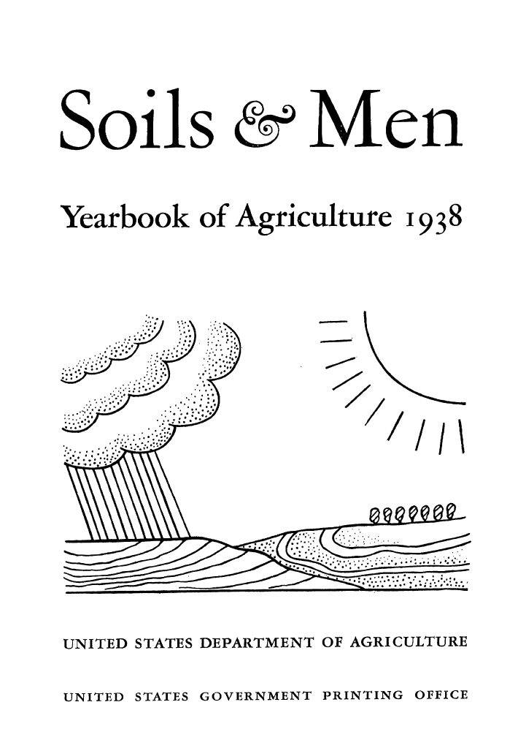
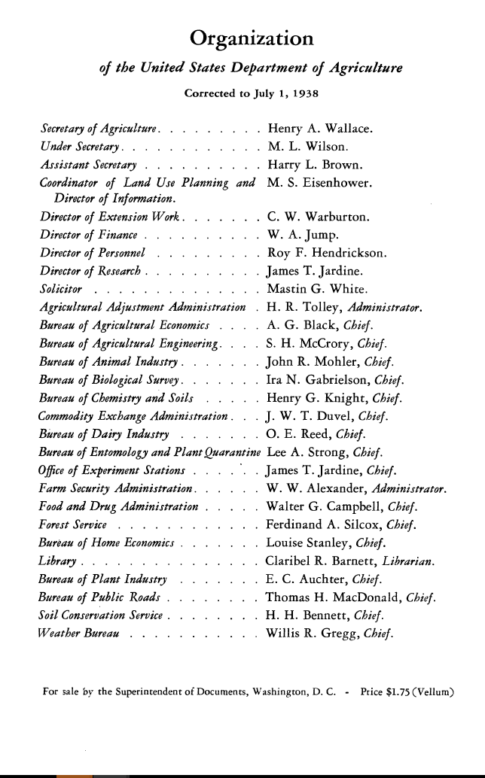
Notes:
This is a document that, with a slight change to the title, has a chapter I love.

Slide 7
People
Notes:
It was shared with me by one of my advisors, Matt Liebman, who is the Henry A Wallace Chair for Sustainable Agriculture here at ISU. That may or not be connected to why he shared it, but I hope the name Henry A Wallace sounds familiar to many of you.

Slide 8
Notes:
He is from Iowa, and was truly incredible. He was the secretary of agriculture, he could be called the inventor of hybrid corn and started Pioneer, which is now Corteva. And he commissioned this report because he was concerned with how we as a nation were treating our soils.

Slide 9
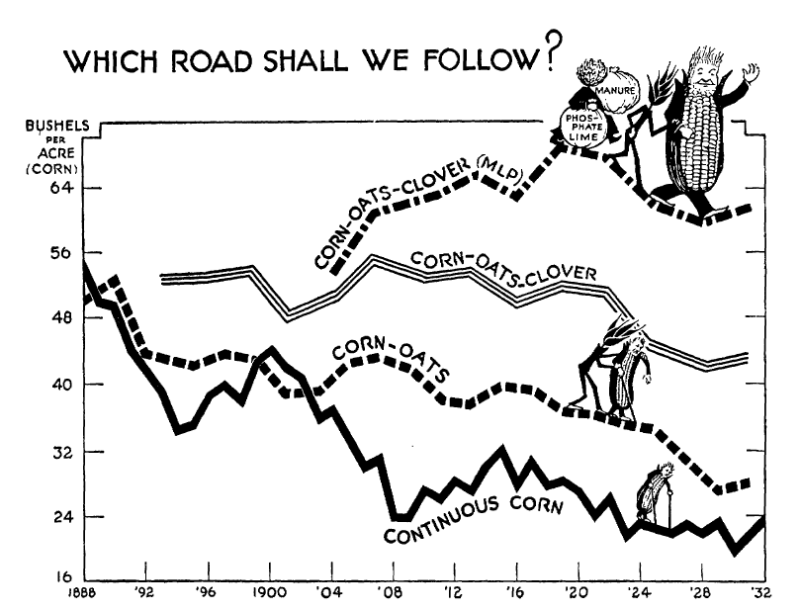
Notes:
There’s a chapter that is basically an ode to crop rotation. Now remember this was in 1938, so a lot of the crop rotation benefit was fertility-based. But even today, this phenomenon holds true.

Slide 10
Even today…

Slide 11
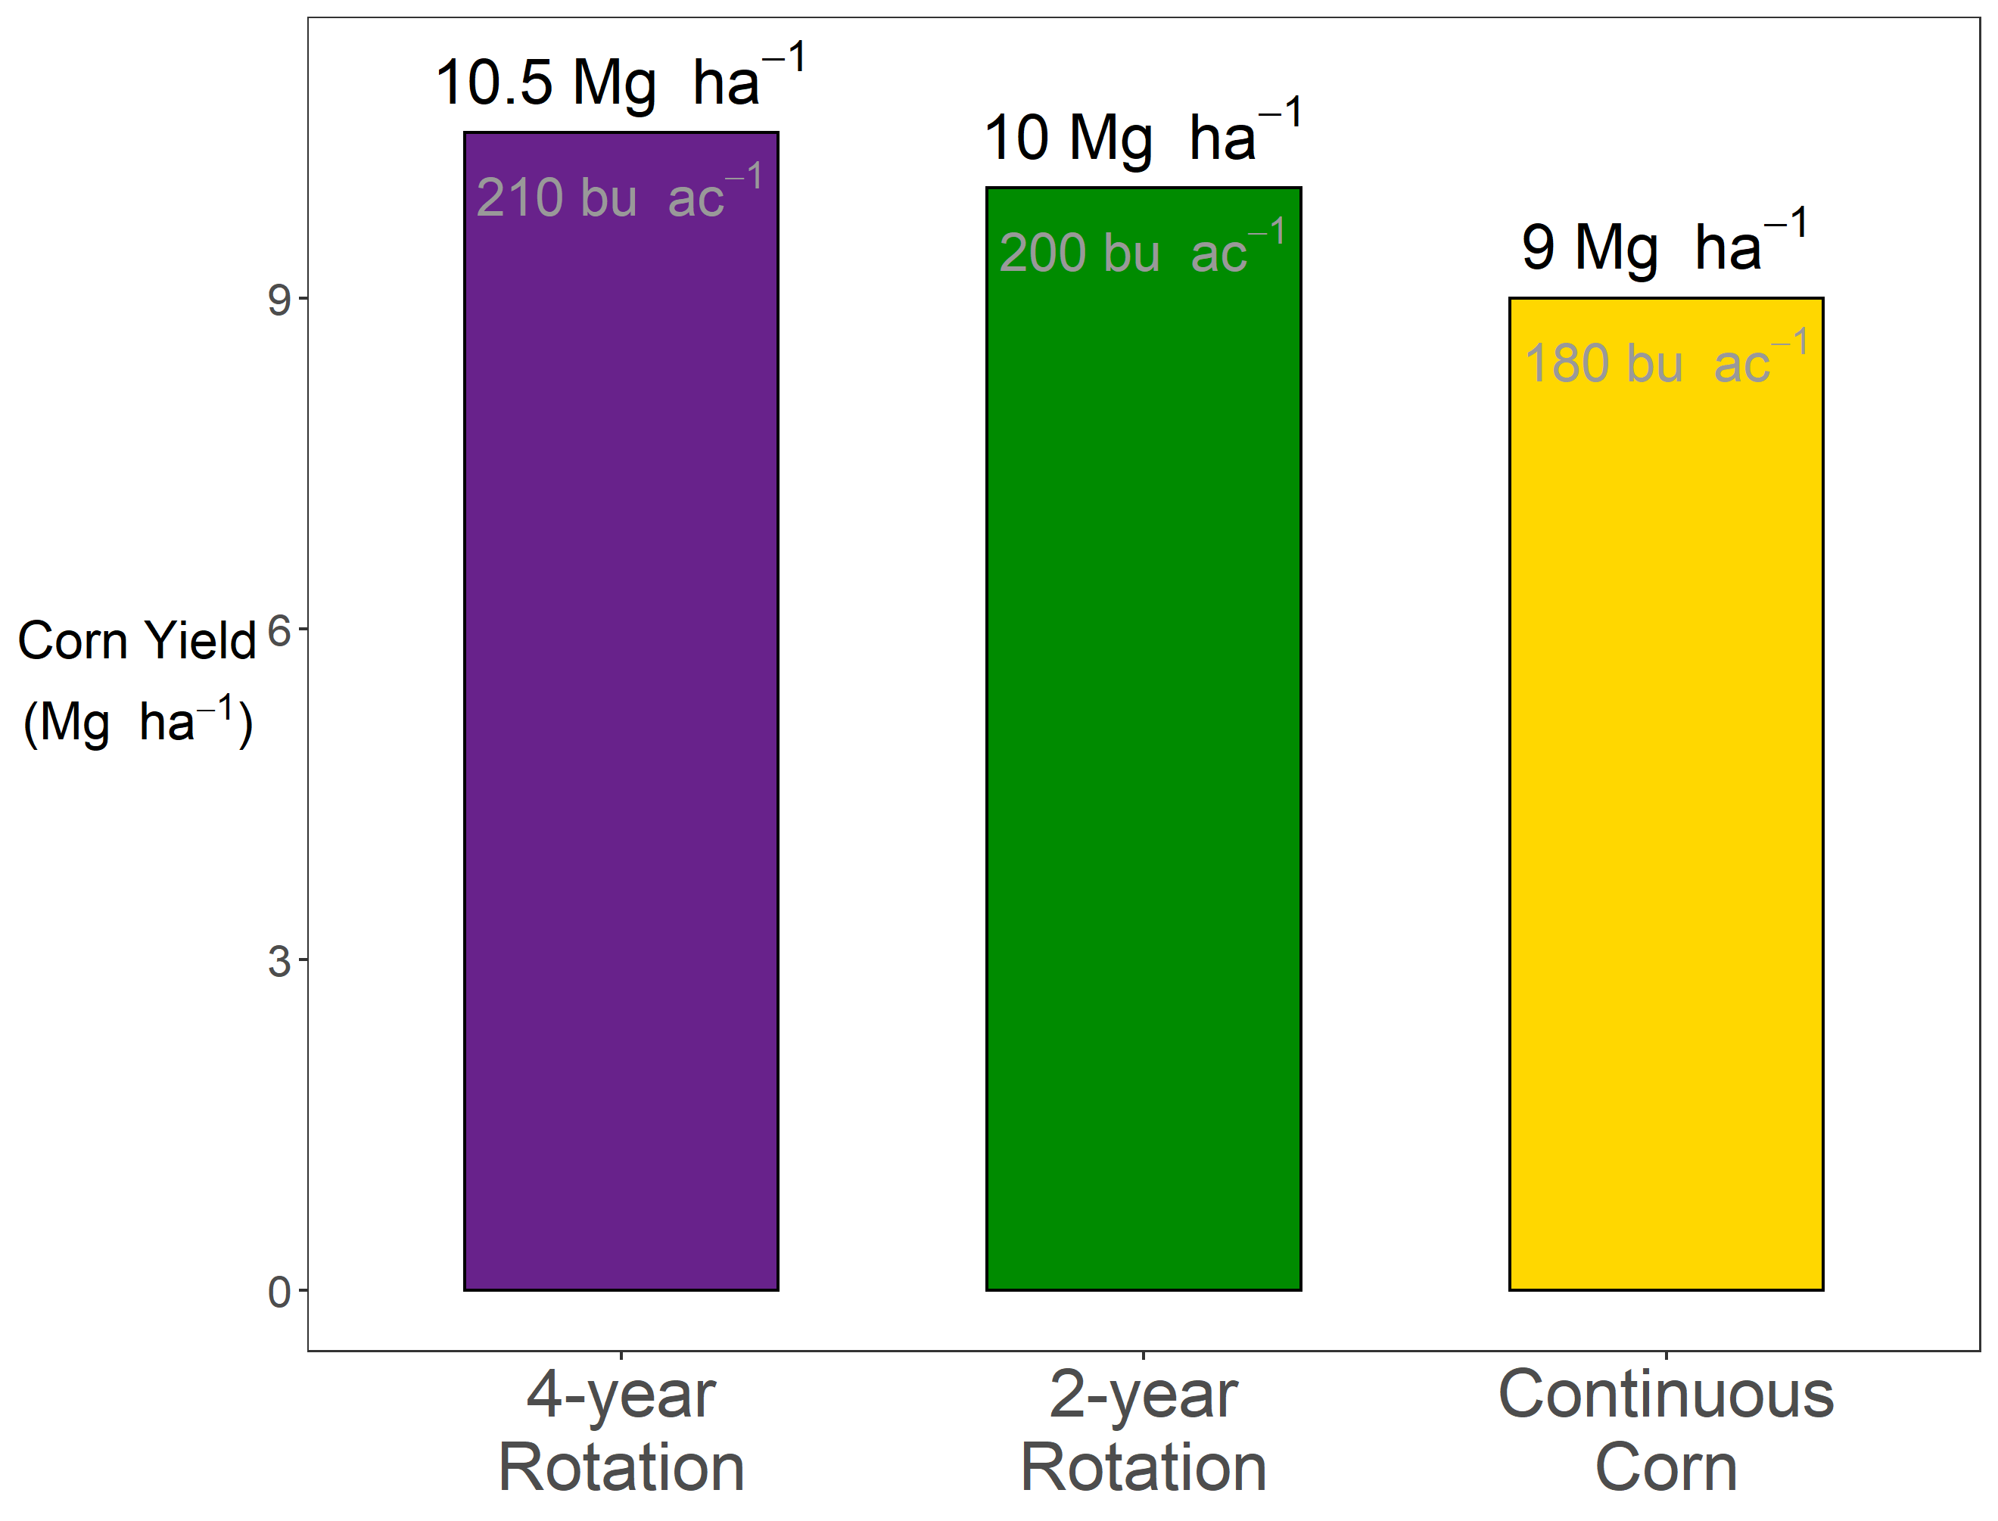



Slide 13
?

Slide 14
The Continuous Corn Penalty

Slide 15
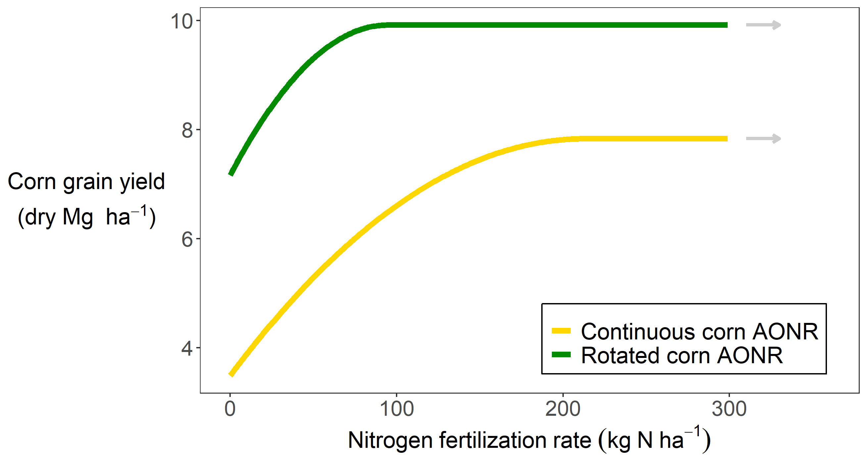
Notes:
Here is how corn responds to nitrogen. On the x-axis we have the amount of mineral nitrogen applied, and on the y-axis is corn yield. If you are growing corn in a field that was soybeans last year and you don’t put any nitrogen on it, you could expect about 7 Mg ha. Note that speaks to the amazing advnaces in genetics we’ve made, for sure. But anyways as you add more nitrogen, your corn yields go up, but they don’t go up forever. At some point they flatten out, and…

Slide 16
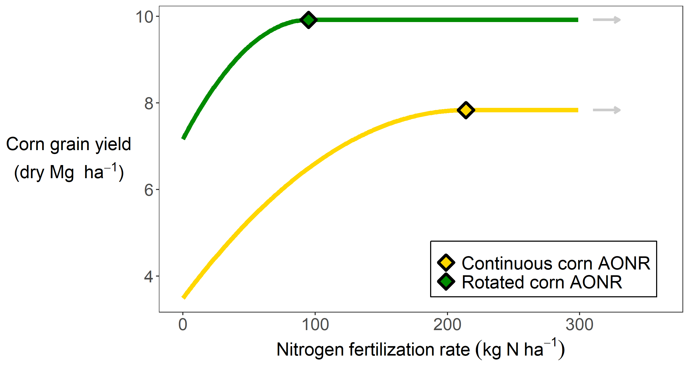
Notes:
That point has a special name – the agronomically optimum nitrogen rate, or AONR. In this case the AONR is about 100 kg of N per hectare. Note that this is ignoring economics. Nitrogen costs money, and depending on the price of corn it might not be worth it to add more nitrogen. But here we are only concerned with biophysical happenings, not what the almighty dollar is worth, so just note this can be calculated in different ways. The curve for corn grown following a corn crop looks different…

Slide 17
Notes:
There’s a lot of information here. Firstly, you can see that when you apply no nitrogen, the continuous corn yields less than the rotated corn. You can partially make up for that by applying more nitrogen, but you can also see you have to apply MORE nitrogen to get to the yield plateau in the continuous corn system. So you are applying MORE THAN TWICE the nitrogen to the continuous corn, your’re getting less yield, and …

Slide 18

Notes:
Some of my other research has shown you can overshoot the AONR in the rotated corn by about 50 kg/ha before your nitrate leaching really starts to skyrocket. In the continuous corn…

Slide 19
Notes:
You can only overapply fertilizer by about 20 kg N/ha before you have issues. So again...

Slide 20
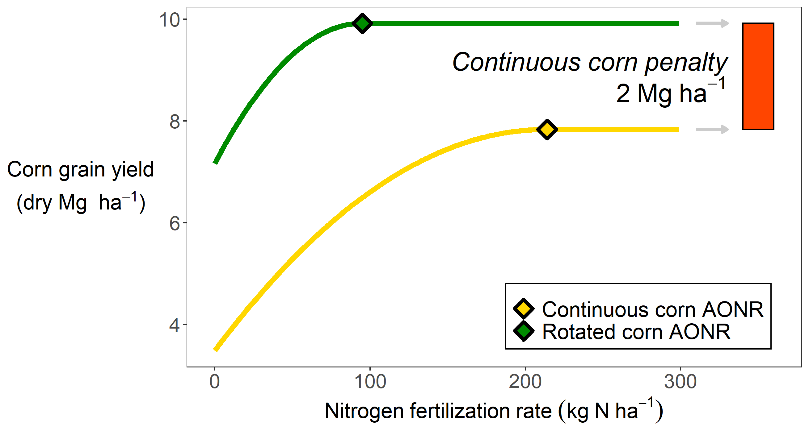
Notes:
To recap, you’re applying more nitrogen, getting less yield, and are at risk of negatively affecting water quality. So when we talk about using land efficiently, and with minimal environmental impact, continuous corn presents major challenges. It’s important to understand why this is happening.

Slide 21
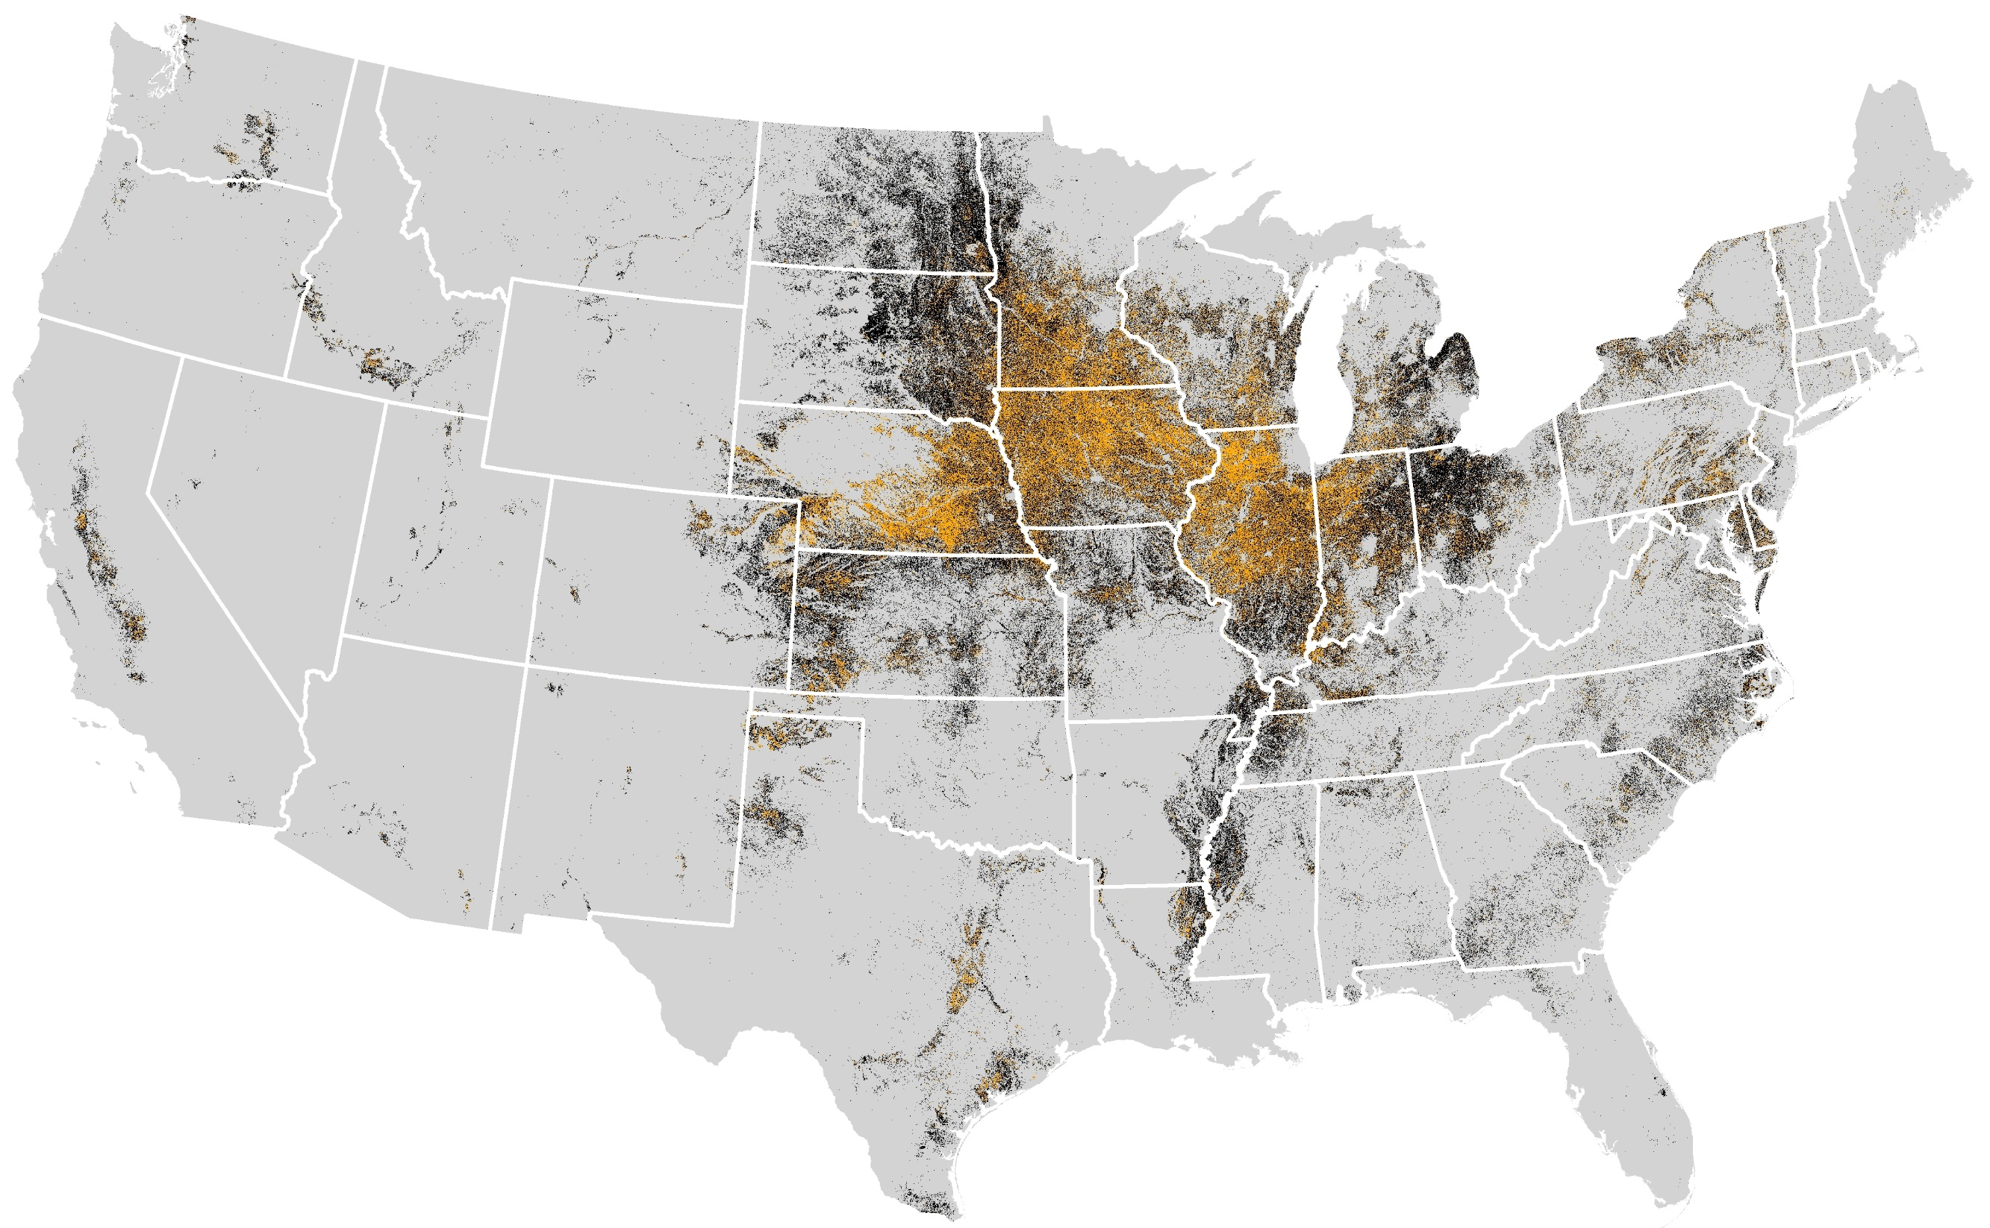
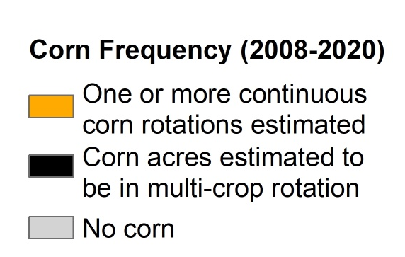
Cont corn map
Corn system (2008-2020)
Corn grown for two or more consecutive years
Corn grown in multi-crop rotation
No corn grown
Map courtesy of Jess Nelson
Data Source: https://www.nass.usda.gov/Research_and_Science/Cropland/Release/index.php
Notes:
The continuous corn penalty affects a significant amount of land. Here, each black dot represents a 30 meter by 30 meter area of land that has had corn on it in the past 12 years. The orange dots represent land that has had corn on it for 2 or more consecutive years in the past 12 years. Approximately one third of all corn grown is subject to the continuous corn penalty.

Slide 22
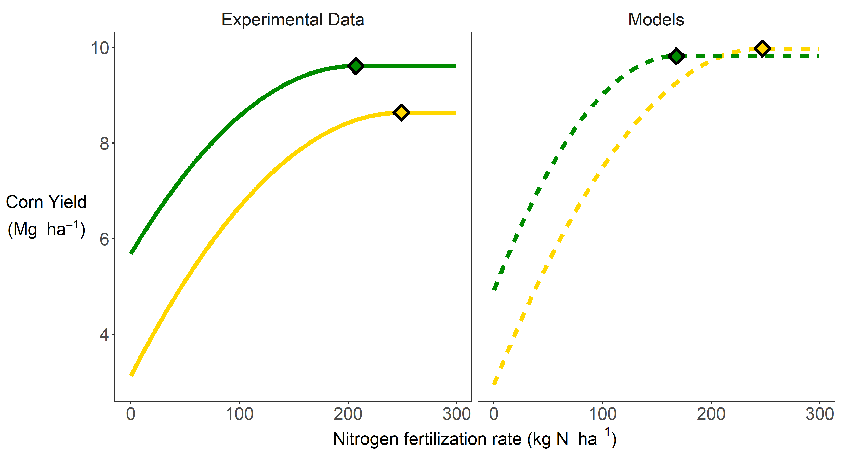
Notes:
On the left you can see what we’ve just been talking about, what experimental data looks like.

Slide 23
Notes:
On the right you can see what models predict these curves to be. You’ll notice the continuous corn curve looks a little different. In addition to tyring to understand causal mechanisms, I was also trying to explore ways to improve model’s abilities to capture the continuous corn penalty.

Slide 24
The Continuous Corn Penalty
Requires more nitrogen, yields less, higher risk of nitrate leaching
Affects a large amount of land
We need a way to model it

Slide 25
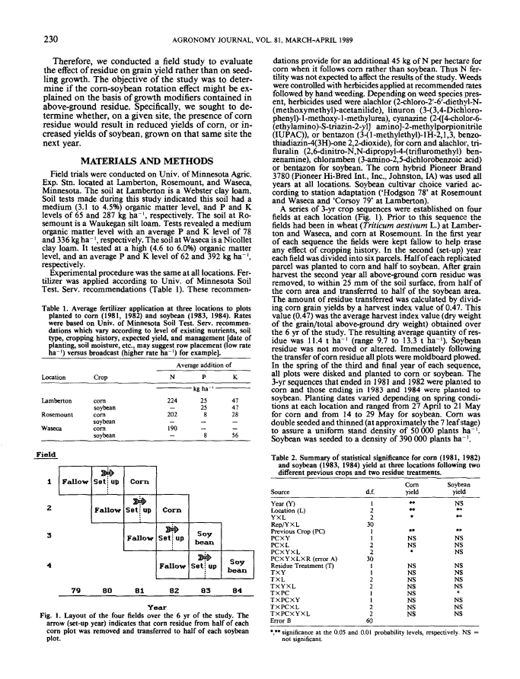

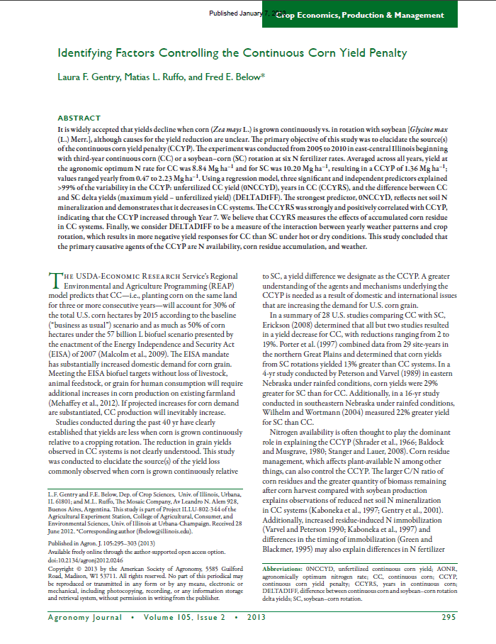
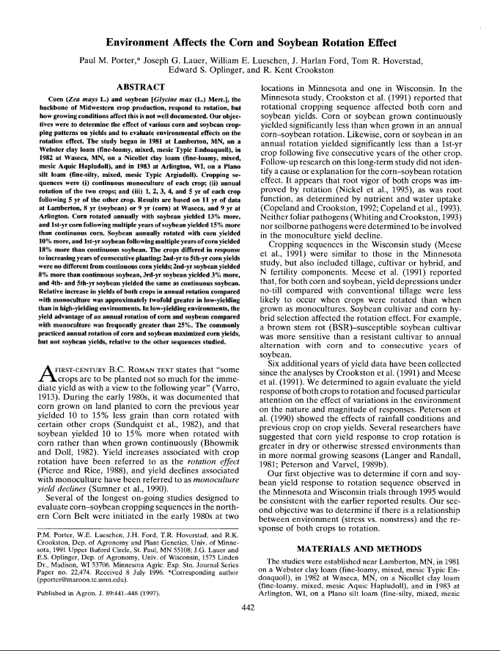
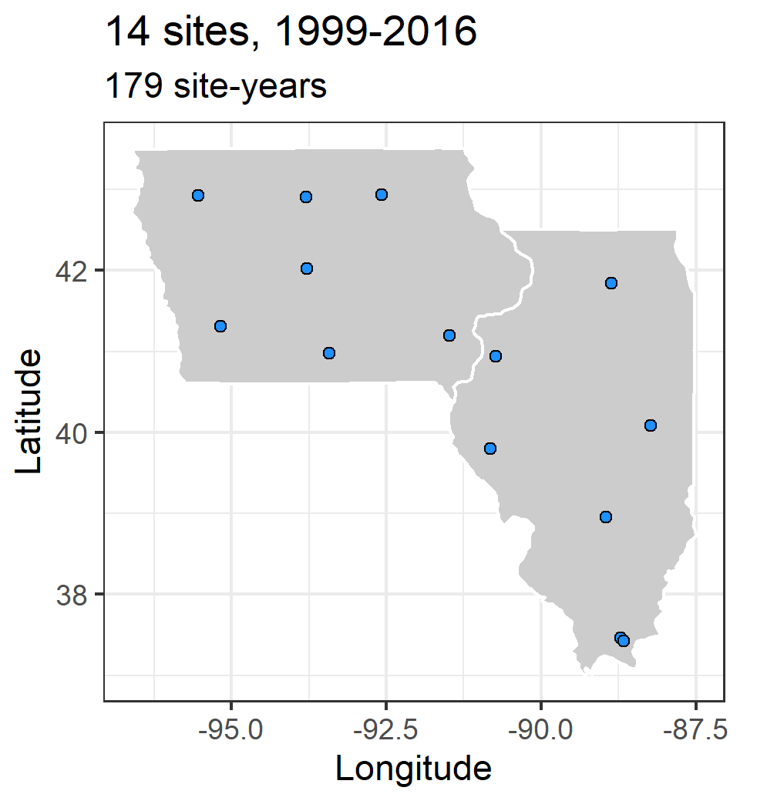
Notes:
To begin to tackle the problem we used a three-pronged approach. Literature review, modelling, and long-term multi-site replicated experimental data.

Slide 26

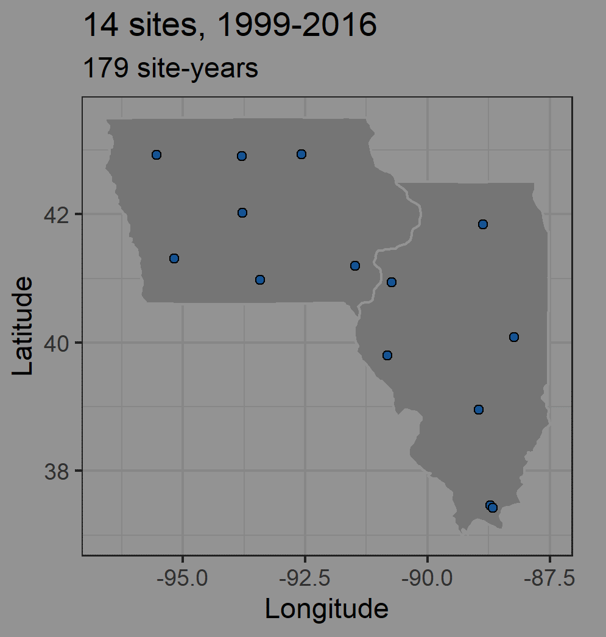
Notes:
To begin to tackle the problem we used a three-pronged approach. Literature review, modelling, and long-term multi-site replicated experimental data.

Slide 27
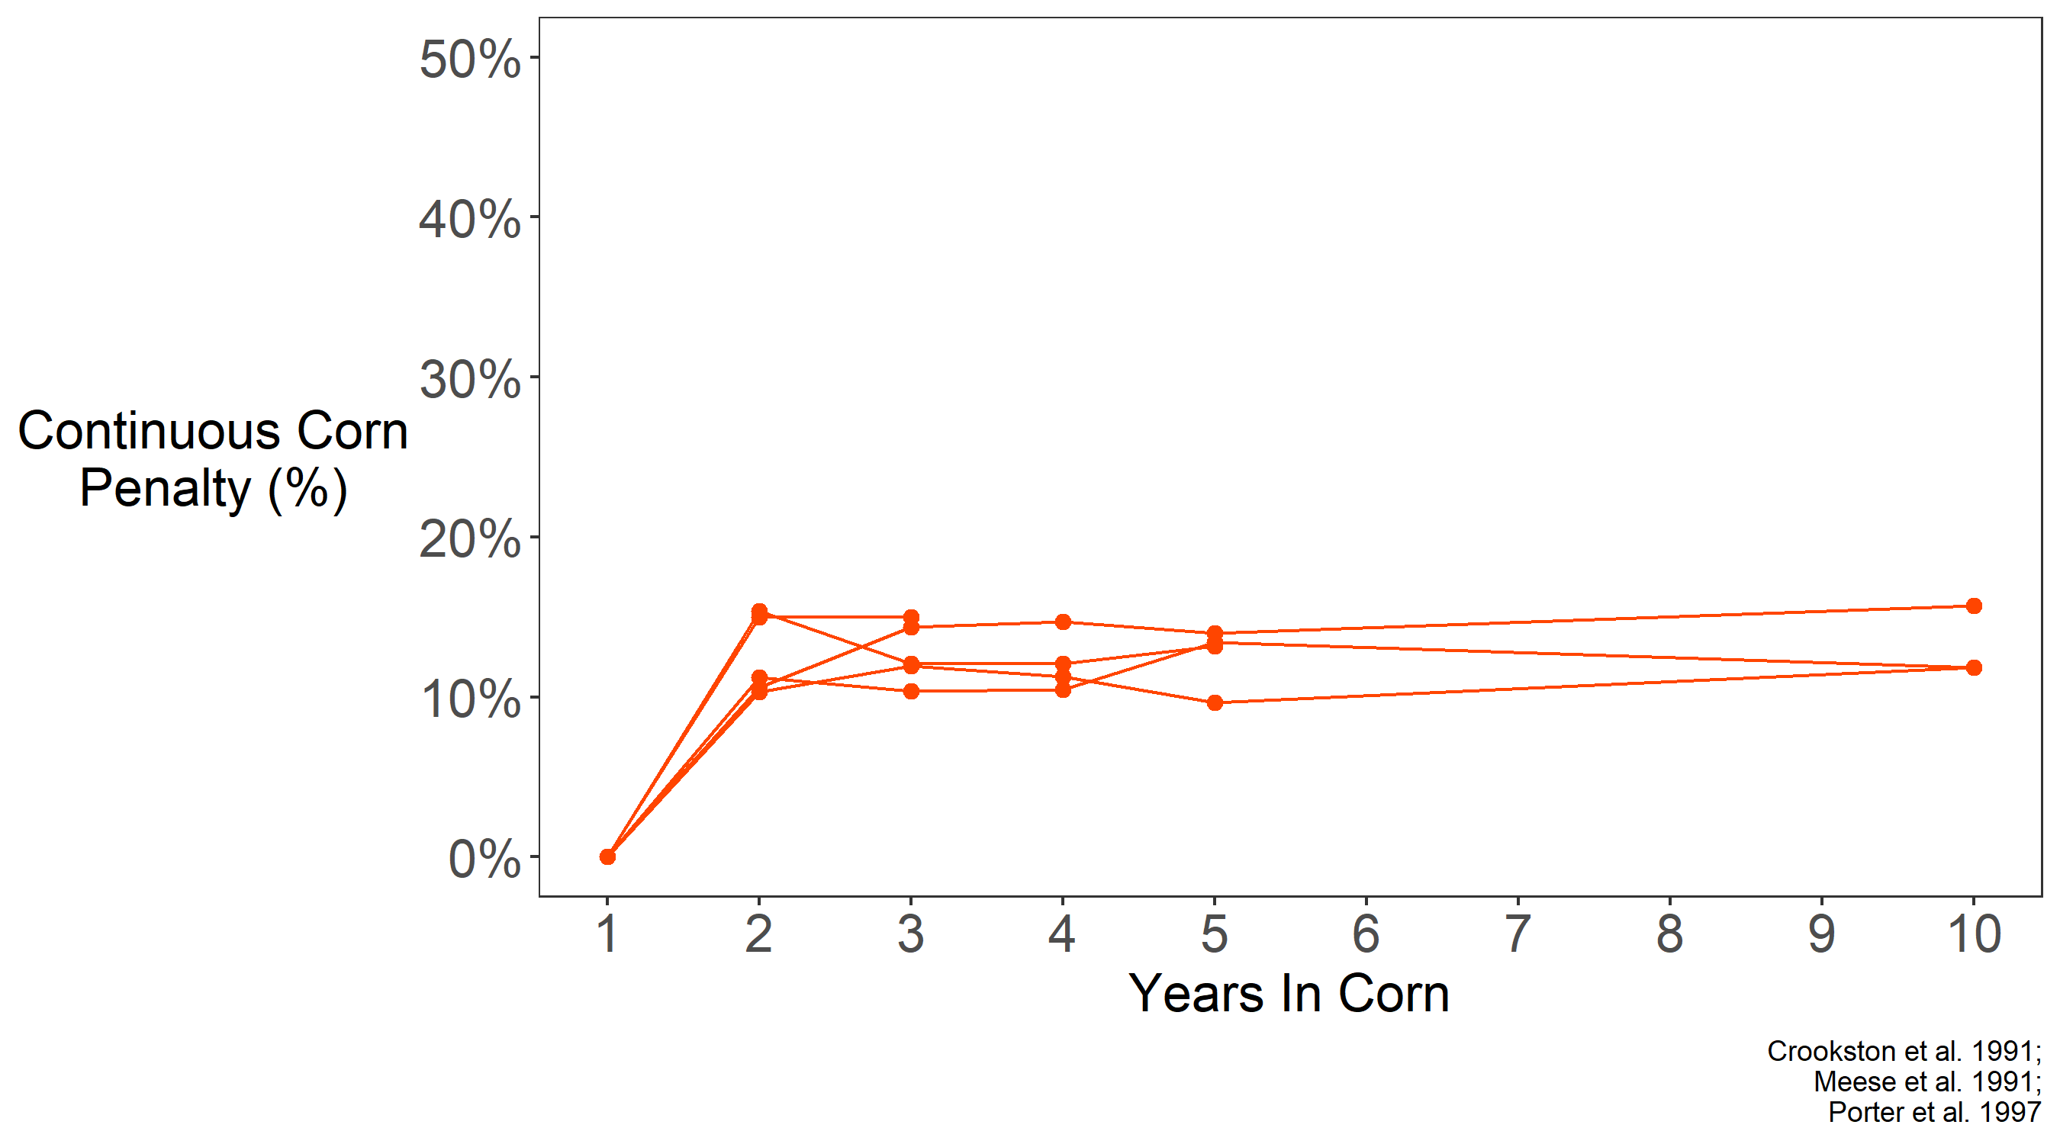
Notes:
The first question I had was whether there was evidence the penalty was related to the number of years in corn. I found three studies that had staggered start dates for the continuous corn treatment, which allowed them to de-confound weather and years in corn. I think this provided strong evidence the causes of the penalty do not accumulate, but are rather a one-year phenomenon and are only related to the previous year’s crop. Some of John Sawyer’s work has also supported this. So this allowed me to focus on thinking about the penalty only being a function of the previous year, which simplifies things drastically.

Slide 28

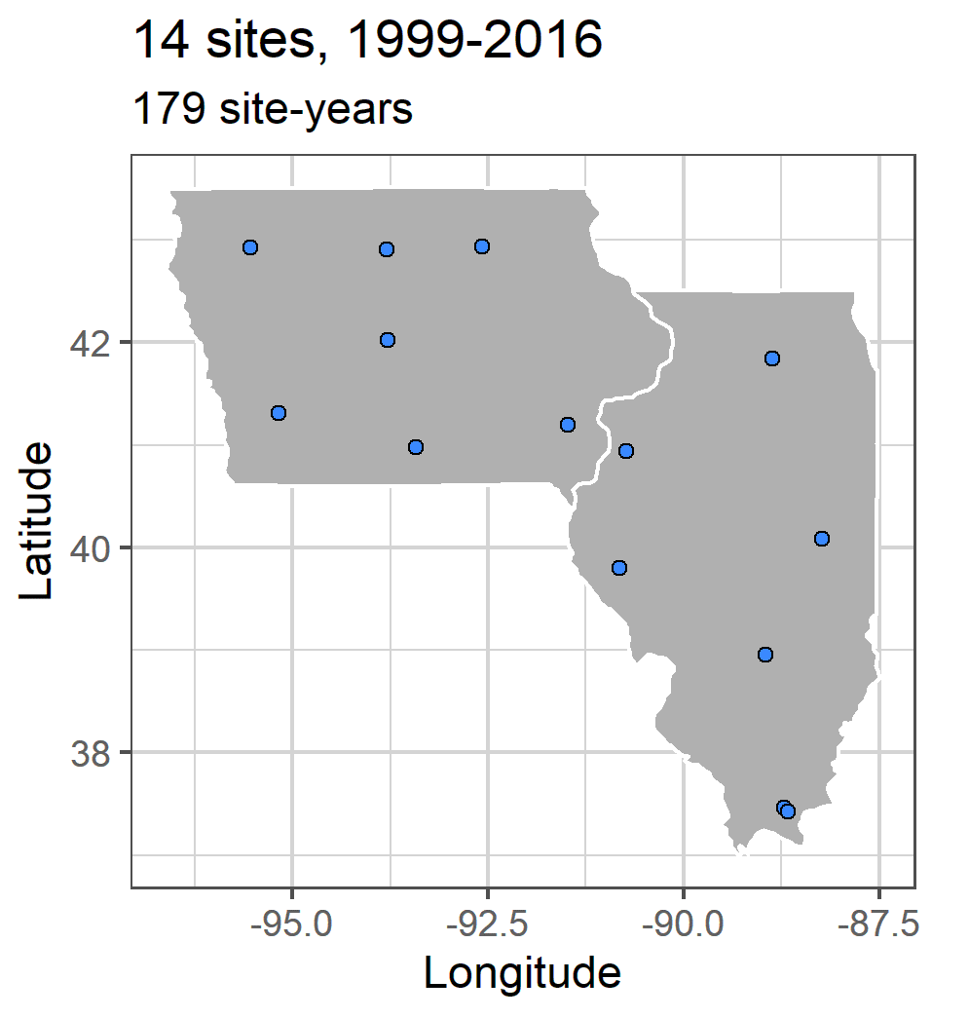
Notes:
To begin to tackle the problem we used a three-pronged approach. Literature review, modelling, and long-term multi-site replicated experimental data.

Slide 29
Notes:
Many states maintain a network of experiments looking at how corn responds to nitrogen (agronomists!). John Sawyer and Emmerson Nafziger, both now retired, managed Iowa and Illinois’ sites, respectively. Each site had a corn-soybean rotation, and a continuous corn rotation, each receiving 3-7 different nitrogen treatments, and replicated at least three times. We used these nitrogen-response curves to estimate the continuous corn penalty for each year at each site.

Slide 30
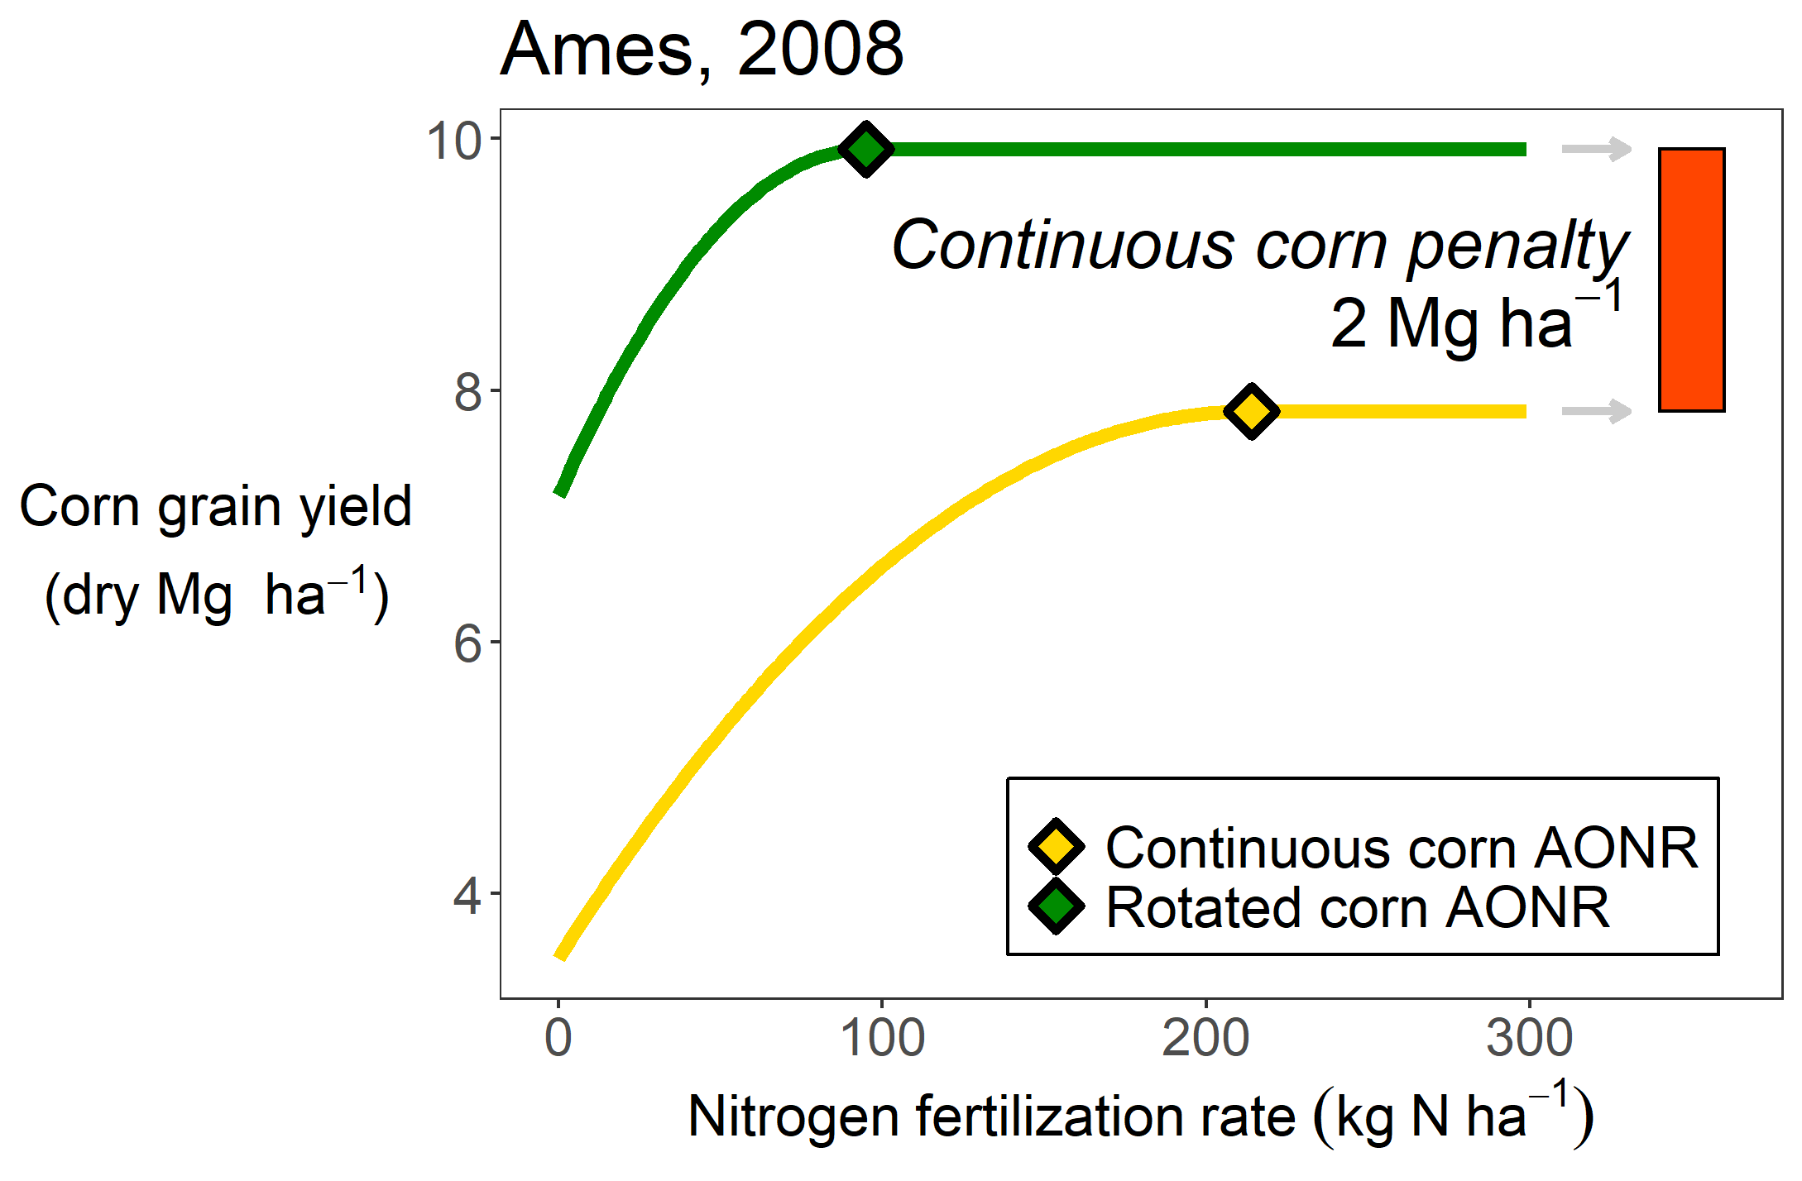
Notes:
Many states maintain a network of experiments looking at how corn responds to nitrogen (agronomists!). John Sawyer and Emmerson Nafziger, both now retired, managed Iowa and Illinois’ sites, respectively. Each site had a corn-soybean rotation, and a continuous corn rotation, each receiving 3-7 different nitrogen treatments, and replicated at least three times. We used these nitrogen-response curves to estimate the continuous corn penalty for each year at each site.

Slide 31
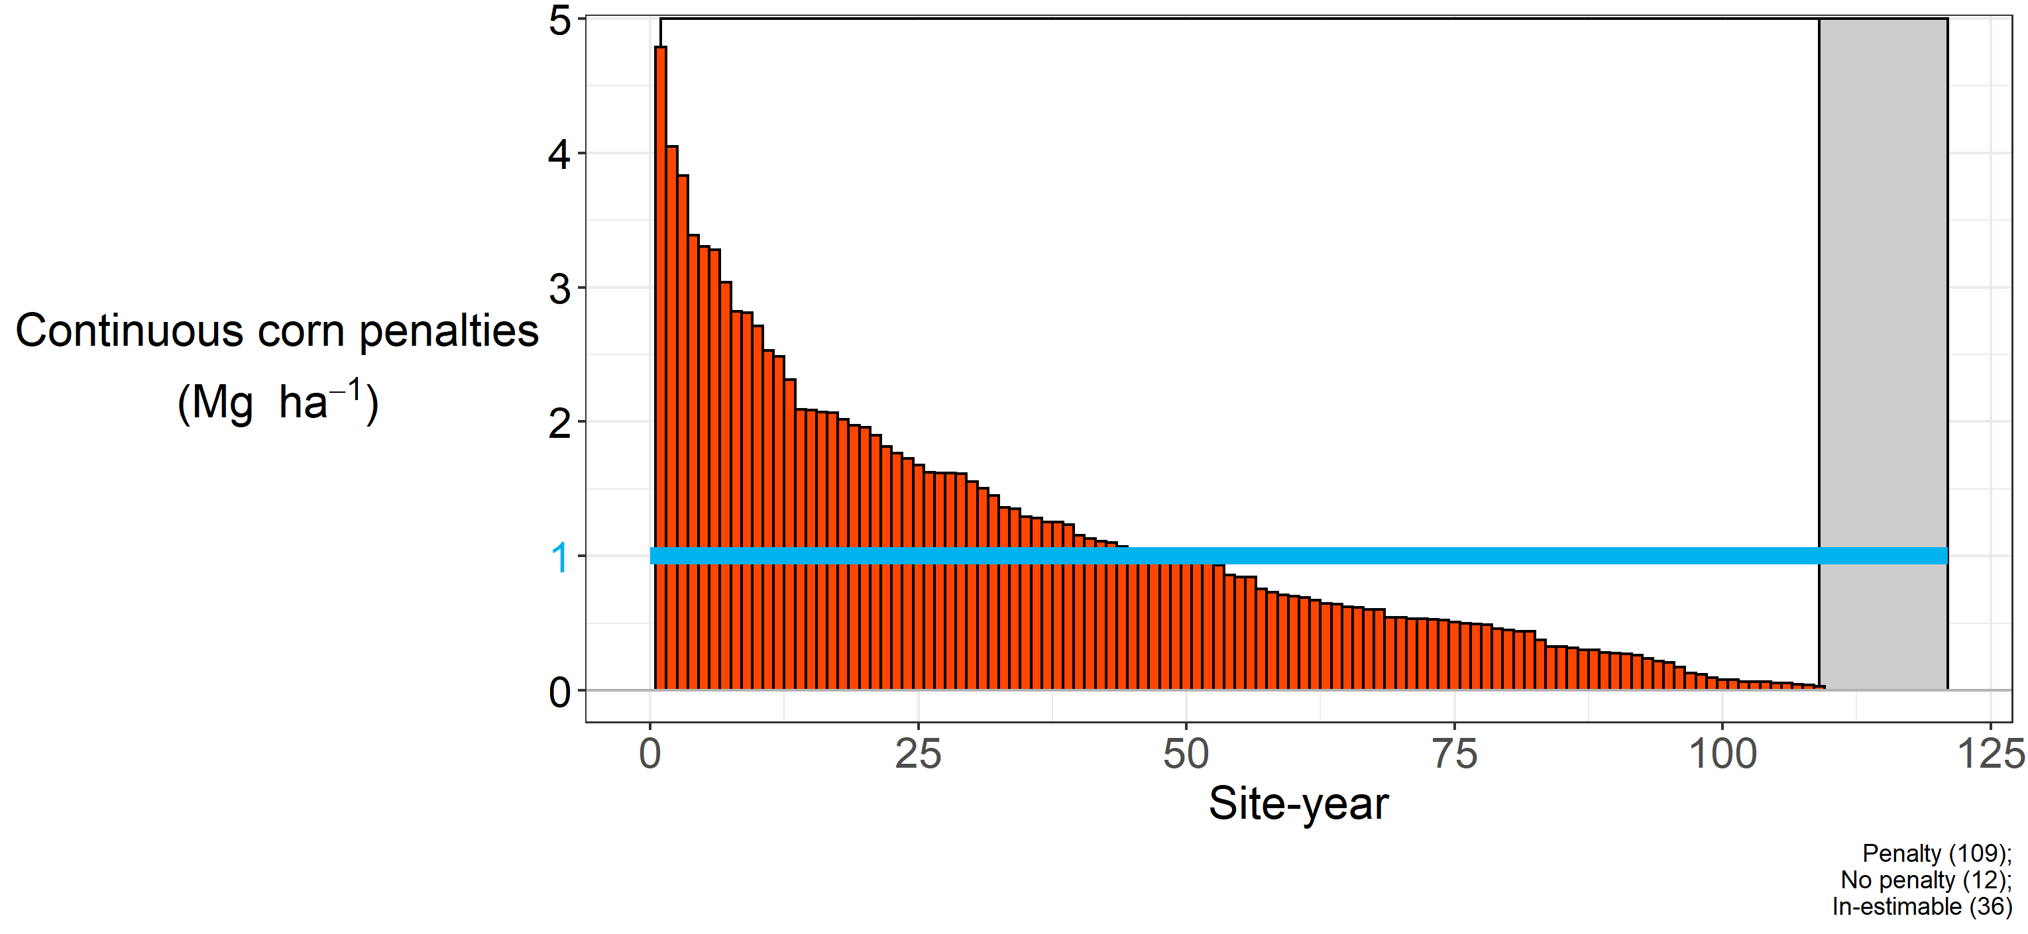
Notes:
Again here’s a little reminder of how I’m calculating this penalty. You can see that even after applying more N, over 90% of the environments had a continuous corn penalty (in 12 cases, adding more nitrogen completely closed the yield gaps). The blue line represents the statistical mean, at 1 Mg ha-1 (roughly 20 bushels).

Slide 32
~10% yield penalty
Notes:
Again here’s a little reminder of how I’m calculating this penalty. You can see that even after applying more N, over 90% of the environments had a continuous corn penalty (in 12 cases, adding more nitrogen completely closed the yield gaps). The blue line represents the statistical mean, at 1 Mg ha-1 (roughly 20 bushels).

Slide 33
Hypothesis
Insufficient soil water recharge following corn
Altered nitrogen cycling
Seedling death
Delayed emergence
Foliar disease
Compromised root growth
Compromised root function
Decreased early plant growth
Notes:
I then extracted a list of hypotheses. These are things that have been suggested, some have been tested but only greenhouses or one or two seasons, and in some cases came from asking agronomists and farmers what they thought.

Slide 34
The Continuous Corn Penalty
Effect does not compound over time
Exists in literature
Exists in our field sites
Lot of proposed causal mechanisms…

Slide 35
Hypothesis
Insufficient soil water recharge following corn
Altered nitrogen cycling
Seedling death
Delayed emergence
Foliar disease
Compromised root growth
Compromised root function
Decreased early plant growth
Notes:
I’m just a PhD student. It’s not realistic for me to go out and do experiments to test all of these things in the field. But what I can do is use a model to do experiments for me.

Slide 36
Notes:
I’m

Slide 37
Open-source
Team of support
Used world-wide
Validated in Midwest

Slide 38
Hypothesis | Model
Insufficient soil water recharge following corn | Look at soil moisture
Altered nitrogen cycling | In progress…
Seedling death | Change planting density
Delayed emergence | Change sowing depth
Foliar disease | Change plant parameter
Compromised root growth | Change plant parameter
Compromised root function | Change plant parameter
Decreased early plant growth | Change plant parameter
Notes:
Figured out most of the are testable using the model. I do want to note this for my committee, Drs. Huth and Castellano especially – I’m not sure the best way to test the altered nitrogen cycling, so that’s something I want to talk about. All of the others were directly testable.

Slide 39
Hypothesis | Model
Insufficient soil water recharge following corn | Look at soil moisture
Altered nitrogen cycling | In progress…
Seedling death | Change planting density
Delayed emergence | Change sowing depth
Foliar disease | Change plant parameter
Compromised root growth | Change plant parameter
Compromised root function | Change plant parameter
Decreased early plant growth | Change plant parameter
Notes:
Figured out most of the are testable using the model. I do want to note this for my committee, Drs. Huth and Castellano especially – I’m not sure the best way to test the altered nitrogen cycling, so that’s something I want to talk about. All of the others were directly testable.

Slide 40
Hypothesis | Model
Insufficient soil water recharge following corn | Look at soil moisture
Altered nitrogen cycling | In progress…
Seedling death | Change planting density
Delayed emergence | Change sowing depth
Foliar disease | Change plant parameter
Compromised root growth | Change plant parameter
Compromised root function | Change plant parameter
Decreased early plant growth | Change plant parameter
Notes:
Figured out most of the are testable using the model. I do want to note this for my committee, Drs. Huth and Castellano especially – I’m not sure the best way to test the altered nitrogen cycling, so that’s something I want to talk about. All of the others were directly testable.

Slide 41
Hypothesis | Model
Insufficient soil water recharge following corn | Look at soil moisture
Altered nitrogen cycling | In progress…
Seedling death | Change planting density
Delayed emergence | Change sowing depth
Foliar disease | Change plant parameter
Compromised root growth | Change plant parameter
Compromised root function | Change plant parameter
Decreased early plant growth | Change plant parameter
Notes:
Figured out most of the are testable using the model. I do want to note this for my committee, Drs. Huth and Castellano especially – I’m not sure the best way to test the altered nitrogen cycling, so that’s something I want to talk about. All of the others were directly testable.

Slide 42
Hypothesis | Model
Insufficient soil water recharge following corn | Look at soil moisture
Altered nitrogen cycling | In progress…
Seedling death | Change planting density
Delayed emergence | Change sowing depth
Foliar disease | Change plant parameter
Compromised root growth | Change plant parameter
Compromised root function | Change plant parameter
Decreased early plant growth | Change plant parameter
Notes:
Figured out most of the are testable using the model. I do want to note this for my committee, Drs. Huth and Castellano especially – I’m not sure the best way to test the altered nitrogen cycling, so that’s something I want to talk about. All of the others were directly testable.

Slide 43
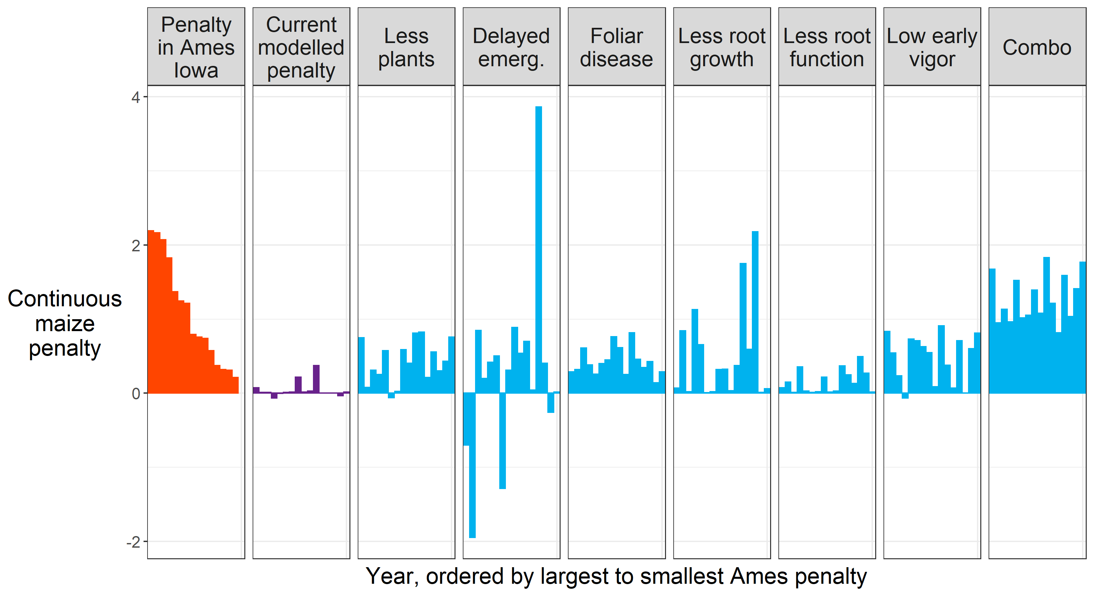
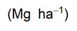
Notes:
These are the results, and I’ll walk you through them. On the left are the experimentally observed penalties for each year, ordered from largest to smallest. This is just for one site, Ames for simplicity.

Slide 44
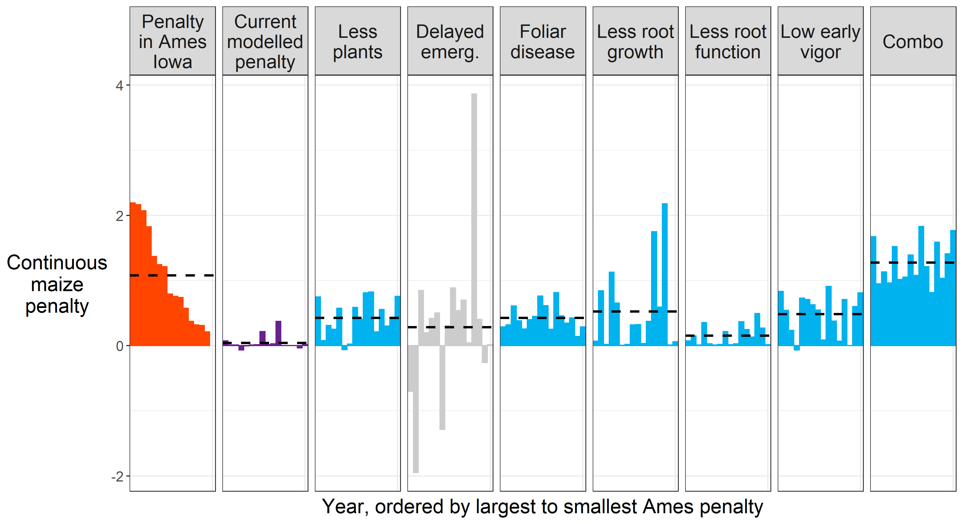
Notes:
These are the results, and I’ll walk you through them. On the left are the experimentally observed penalties for each year, ordered from largest to smallest. This is just for one site, Ames for simplicity.

Slide 45
Notes:
These are the results, and I’ll walk you through them. On the left are the experimentally observed penalties for each year, ordered from largest to smallest. This is just for one site, Ames for simplicity.

Slide 46
The Continuous Corn Penalty
Maximum rooting depth
Growth analysis
Yield components
Surface residue at planting

Slide 47
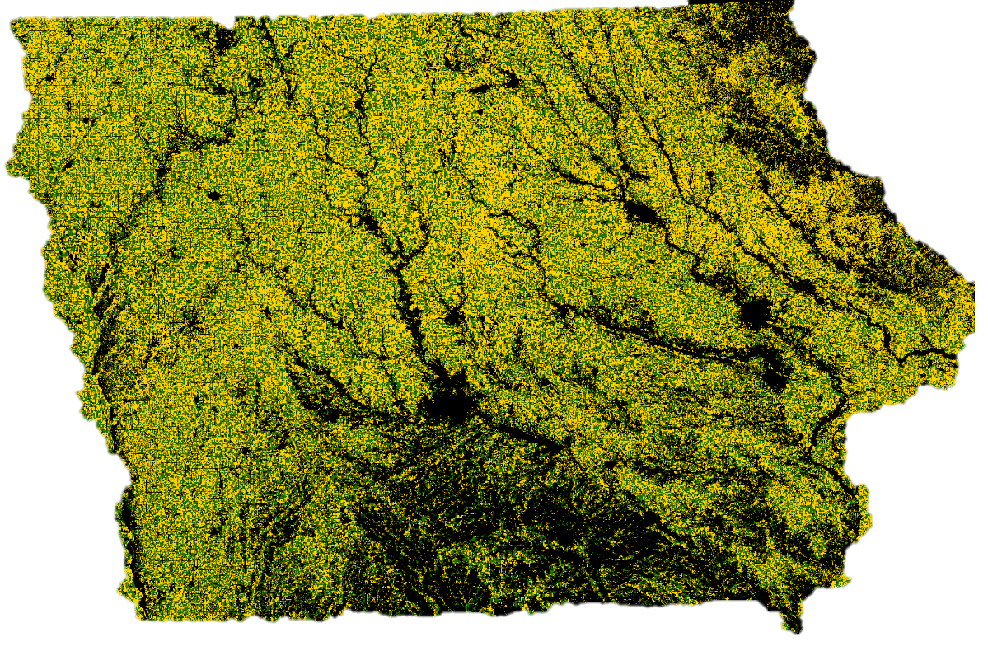
Notes:
Soil erosion. The very first question of sustainability, and our cropping systems fail it. We are losing soil faster than we are creating it. Additionally, soil is shifting (we are just losing production potential, it’s not increasing production potential where it goes). Water quality almost goes without saying. Air quality. Iowa ranks 49th in public land holdings at 0.2%.

Slide 49

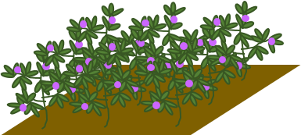

Slide 50
The Rotation Effect

Slide 51
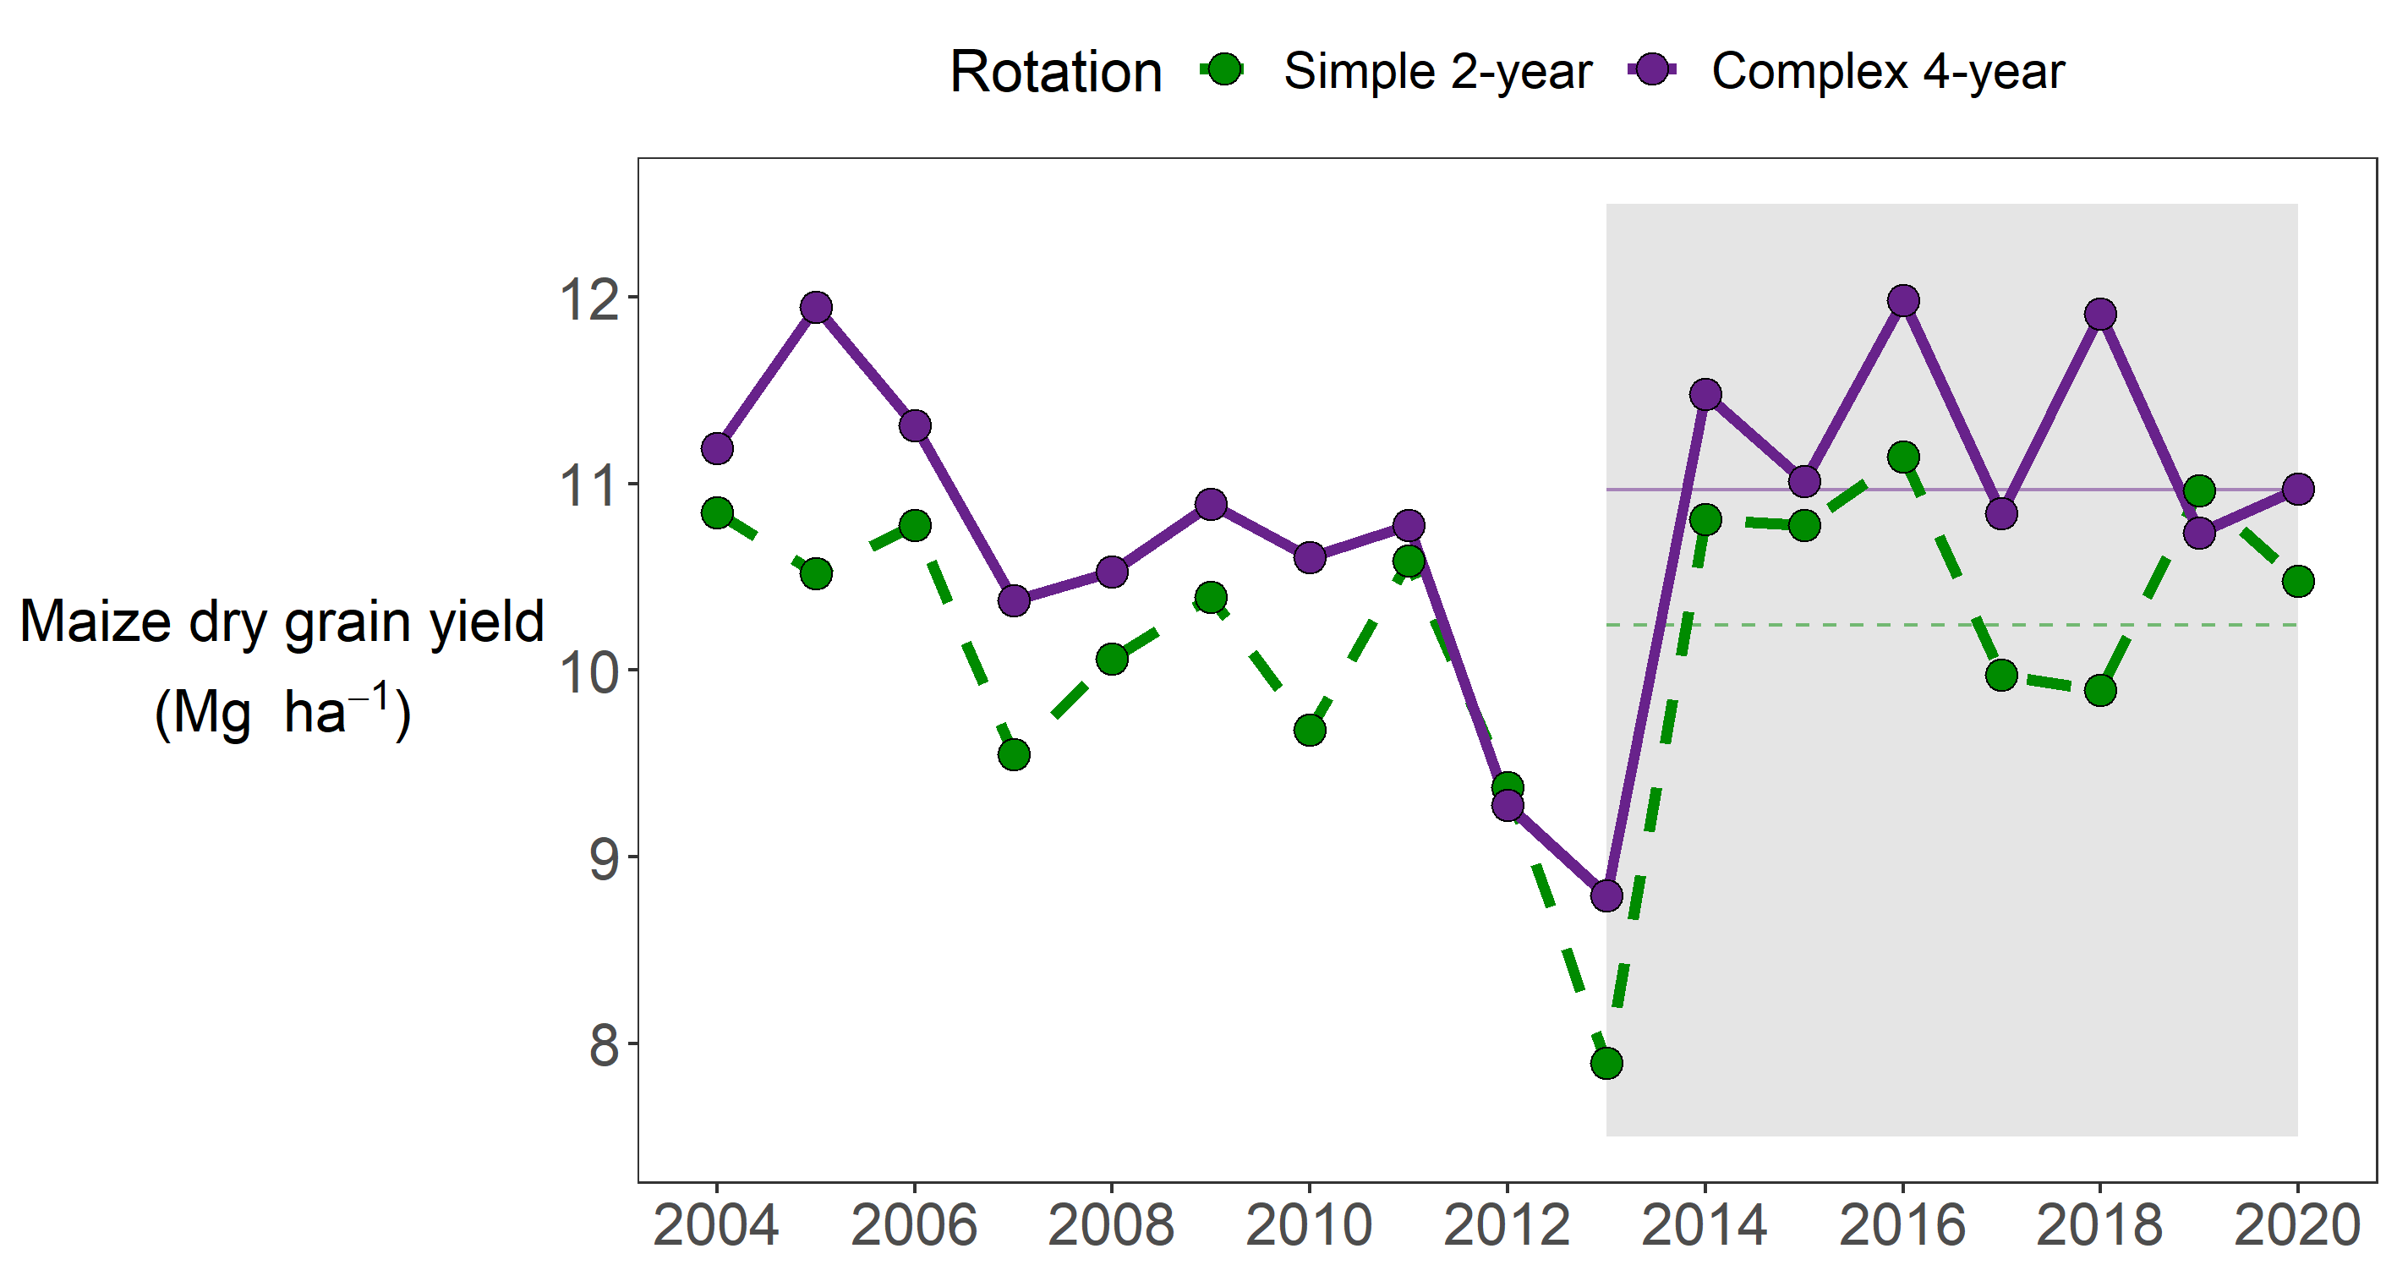
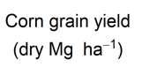

Slide 52
Suite of field measurements
Grain yields
Above ground biomass
500-kernel weights
Residue
Soil penetration resistance
Soil moisture
Depth to water table
Rooting depth
Root mass

Slide 53
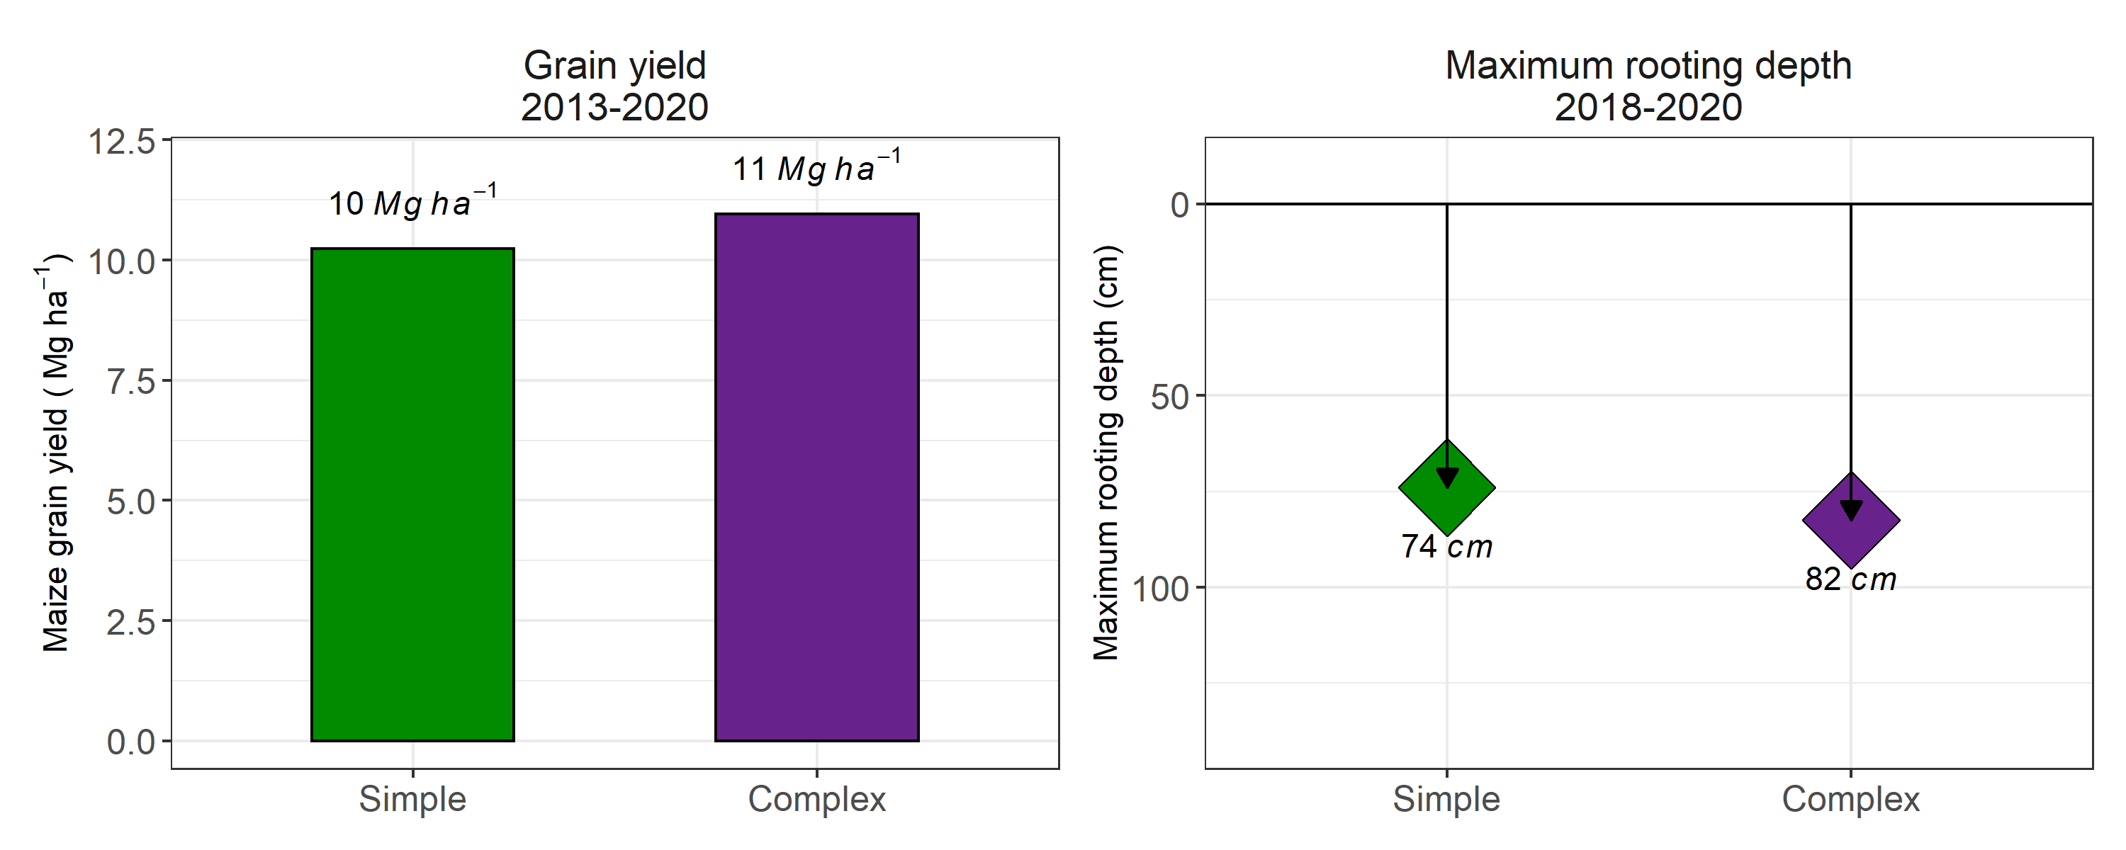

Slide 54
What I did
Why I did it

Slide 56


Slide 57
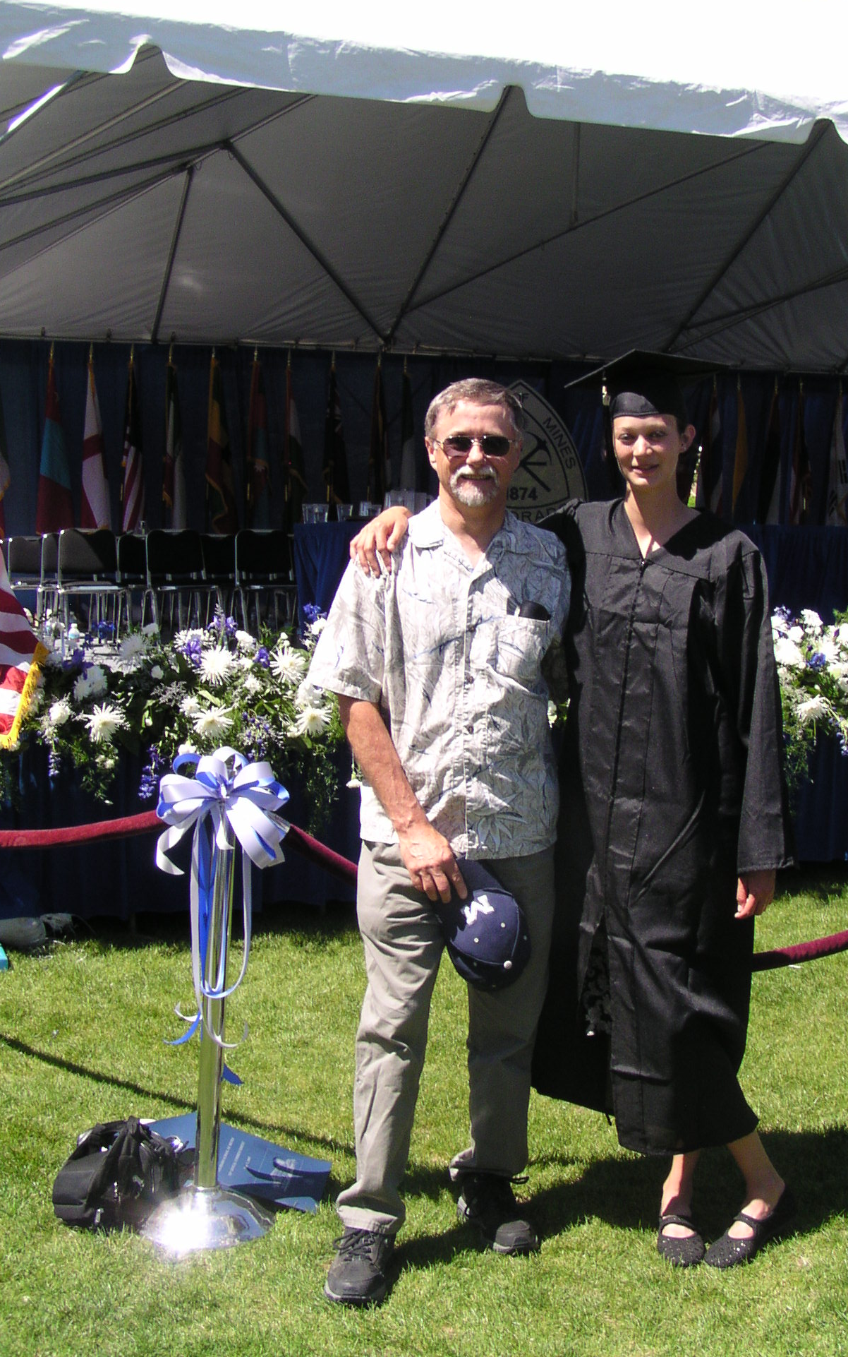

Slide 58


Slide 59
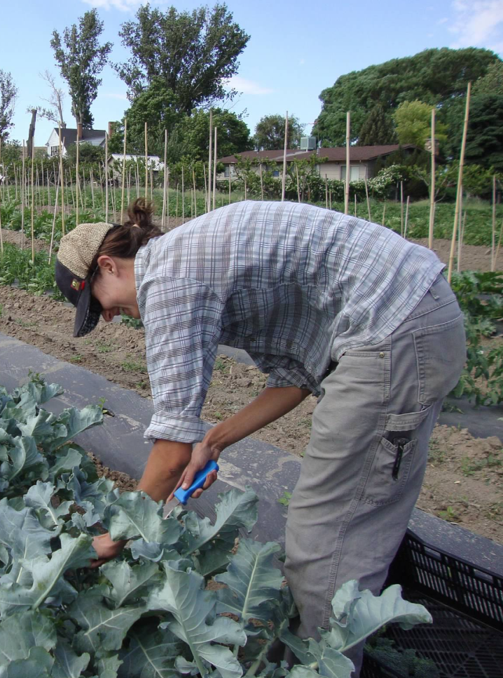

Slide 60
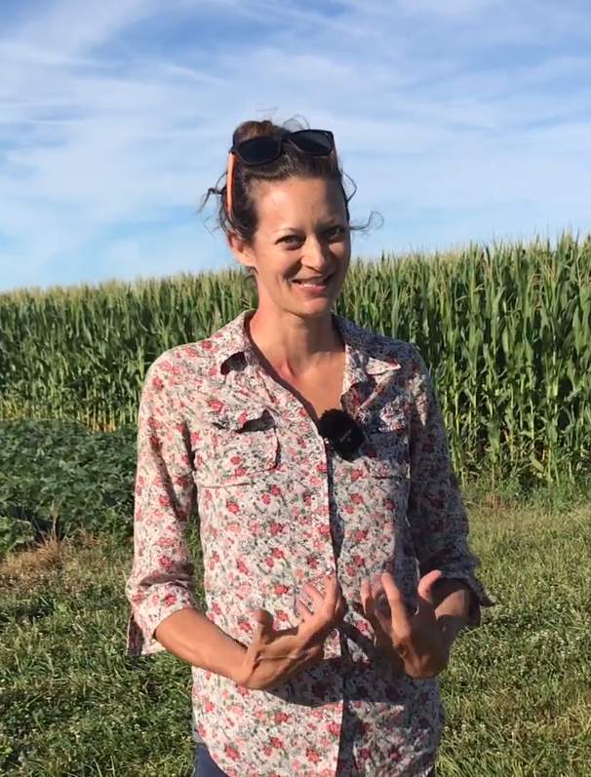

Slide 61
How can agriculture be done such that the farmer, their community, society, and the environment all benefit?

Slide 62
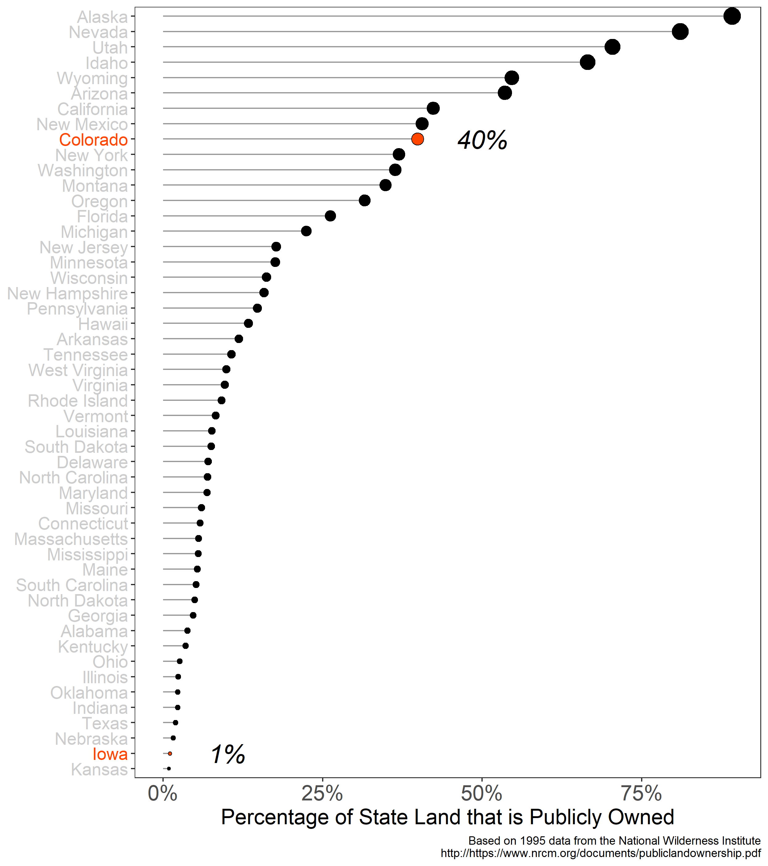

Slide 63
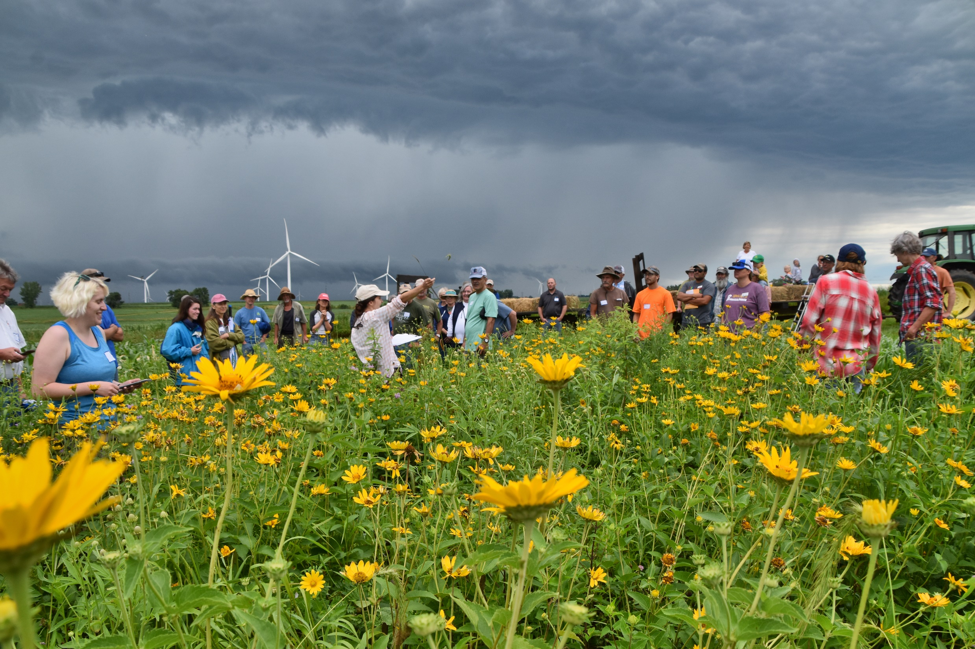

Slide 64
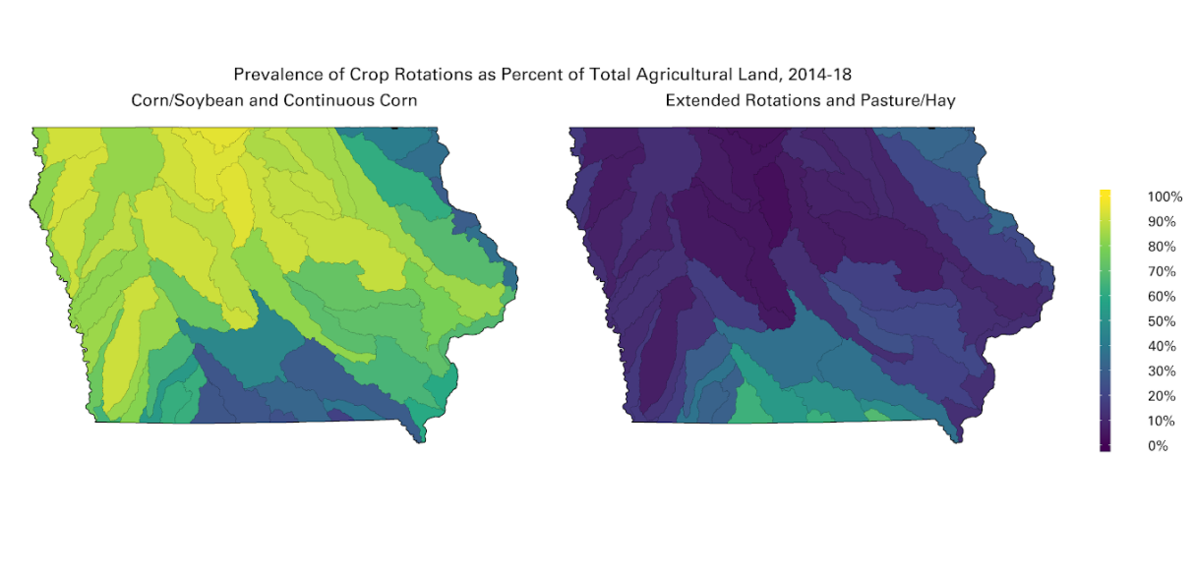
Courtesy of Laurie Nowatzke
Data Source: https://www.nass.usda.gov/Research_and_Science/Cropland/Release/index.php

Slide 65
Courtesy of Laurie Nowatzke
Data Source: https://www.nass.usda.gov/Research_and_Science/Cropland/Release/index.php

Slide 66
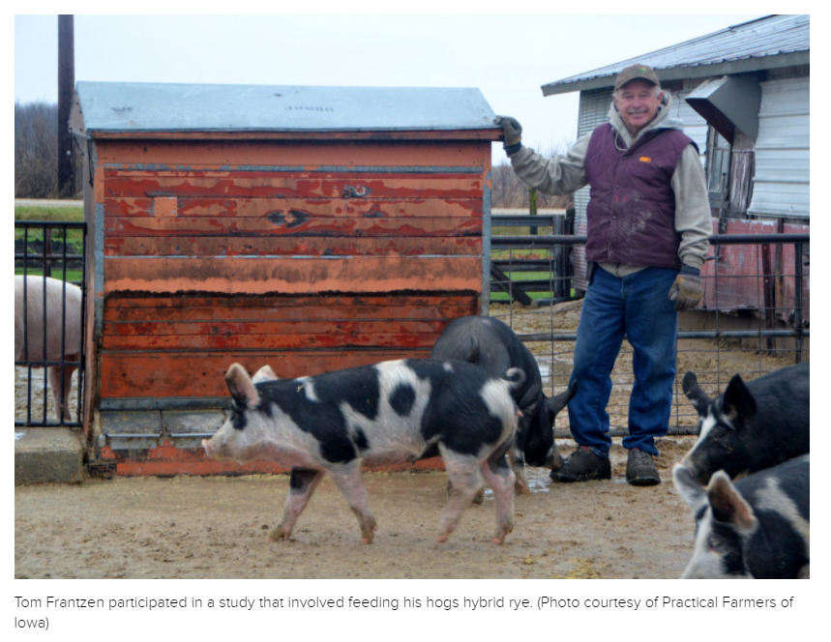
https://civileats.com/2021/08/10/hybrid-rye-is-helping-farmers-fight-superweeds-without-herbicide/

Slide 67
https://civileats.com/2021/08/10/hybrid-rye-is-helping-farmers-fight-superweeds-without-herbicide/
…In Europe, hybrid rye was developed by university researchers working with KWS. Tom Frantzen is thrilled that he has a new rotational crop, but concerned that it’s not based on homegrown science. “Why isn’t this work being done in the Midwest?” he asks.

Slide 68
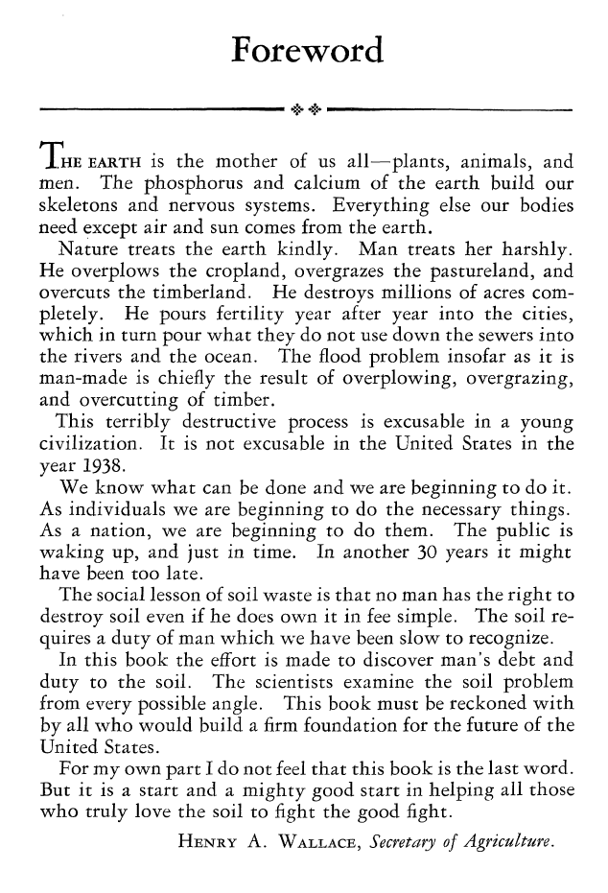

Slide 69
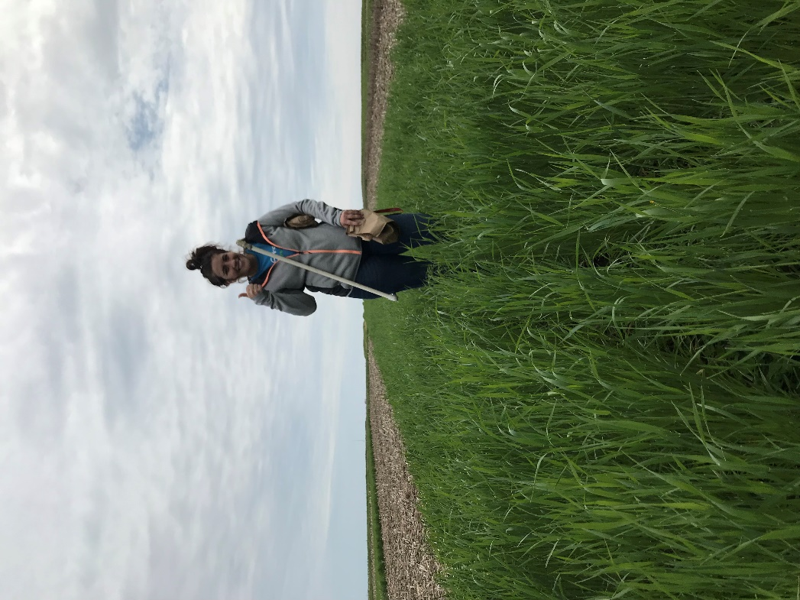
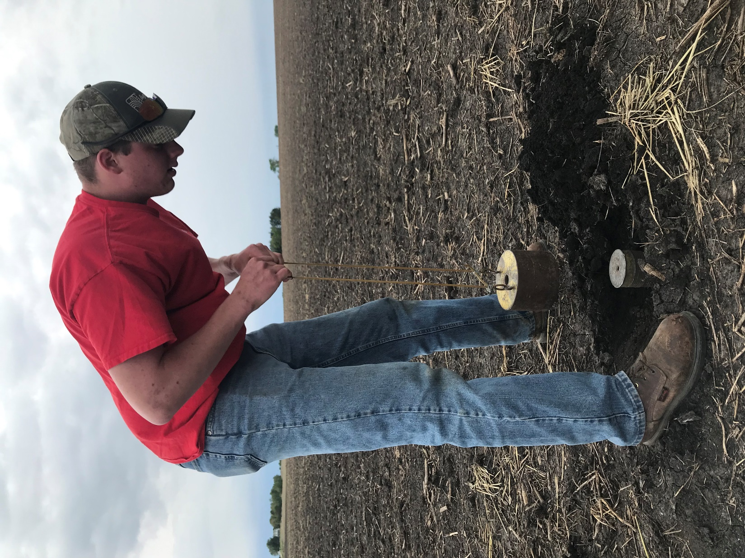
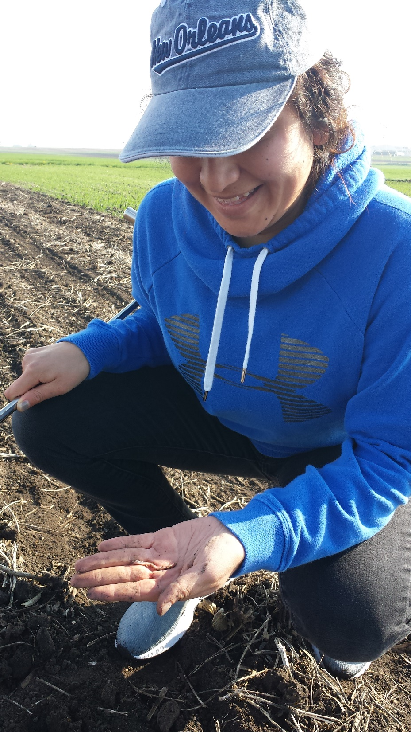

Slide 70
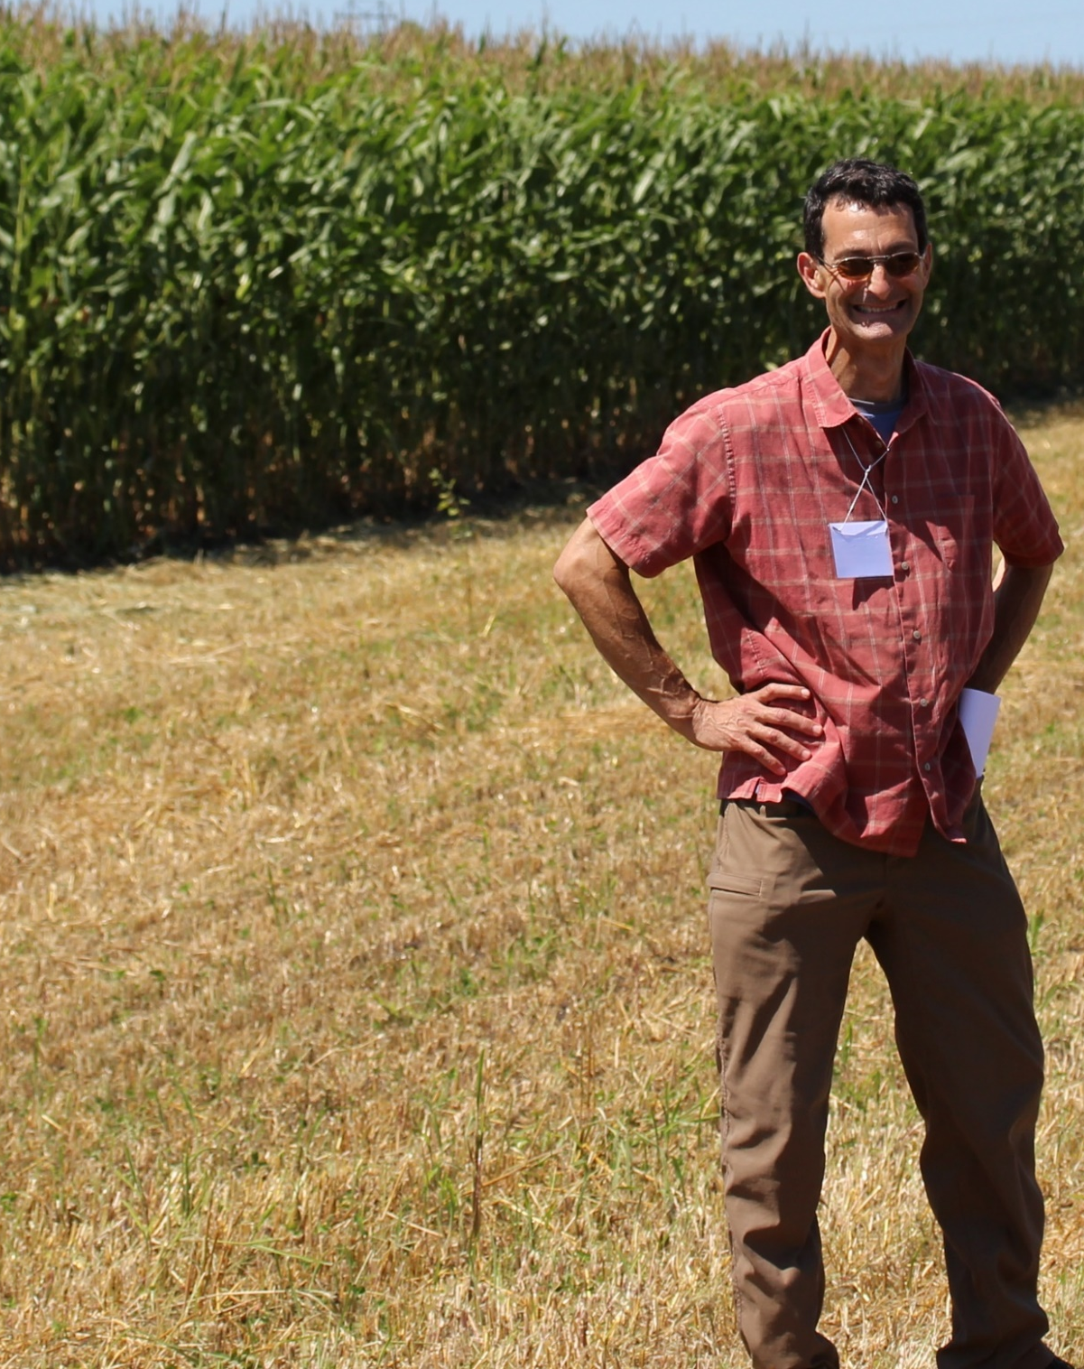
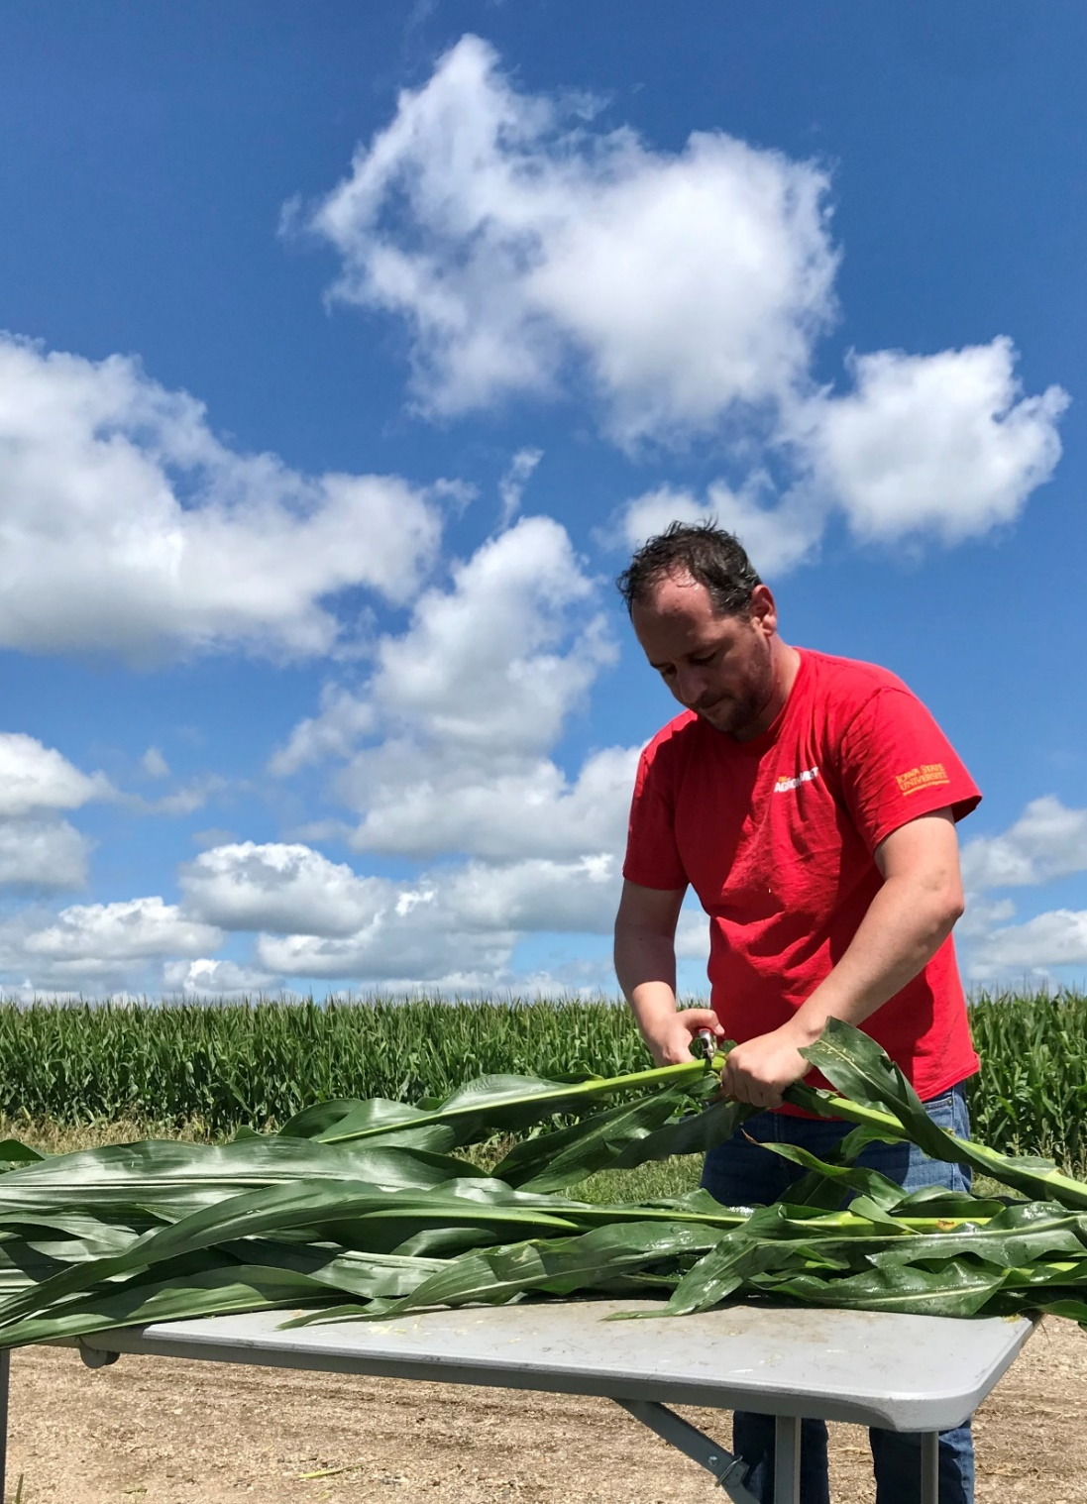
Sotirios Archontoulis
Assistant Professor
Agronomy Dept.
Iowa State University
Matt Liebman
Professor
Agronomy Dept.
Iowa State University

Slide 71
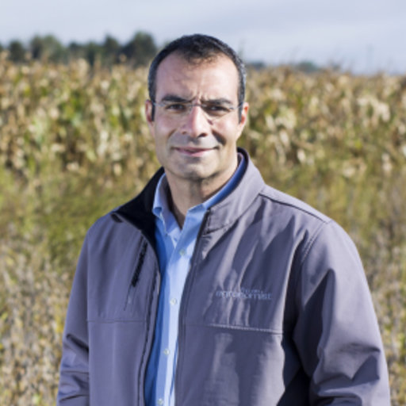

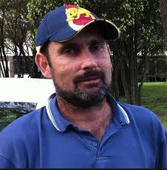

Mike Castellano
Associate Professor
Agronomy Dept.
Iowa State University
Jerry Hatfield
Fomer Laboratory Director
National Lab for Ag & the Env
USDA (retired!)
Neil Huth
Principal Research Scientist
CSIRO, Australia
Jarad Niemi
Associate Professor
Statistics Depart.
Iowa State University

Slide 73
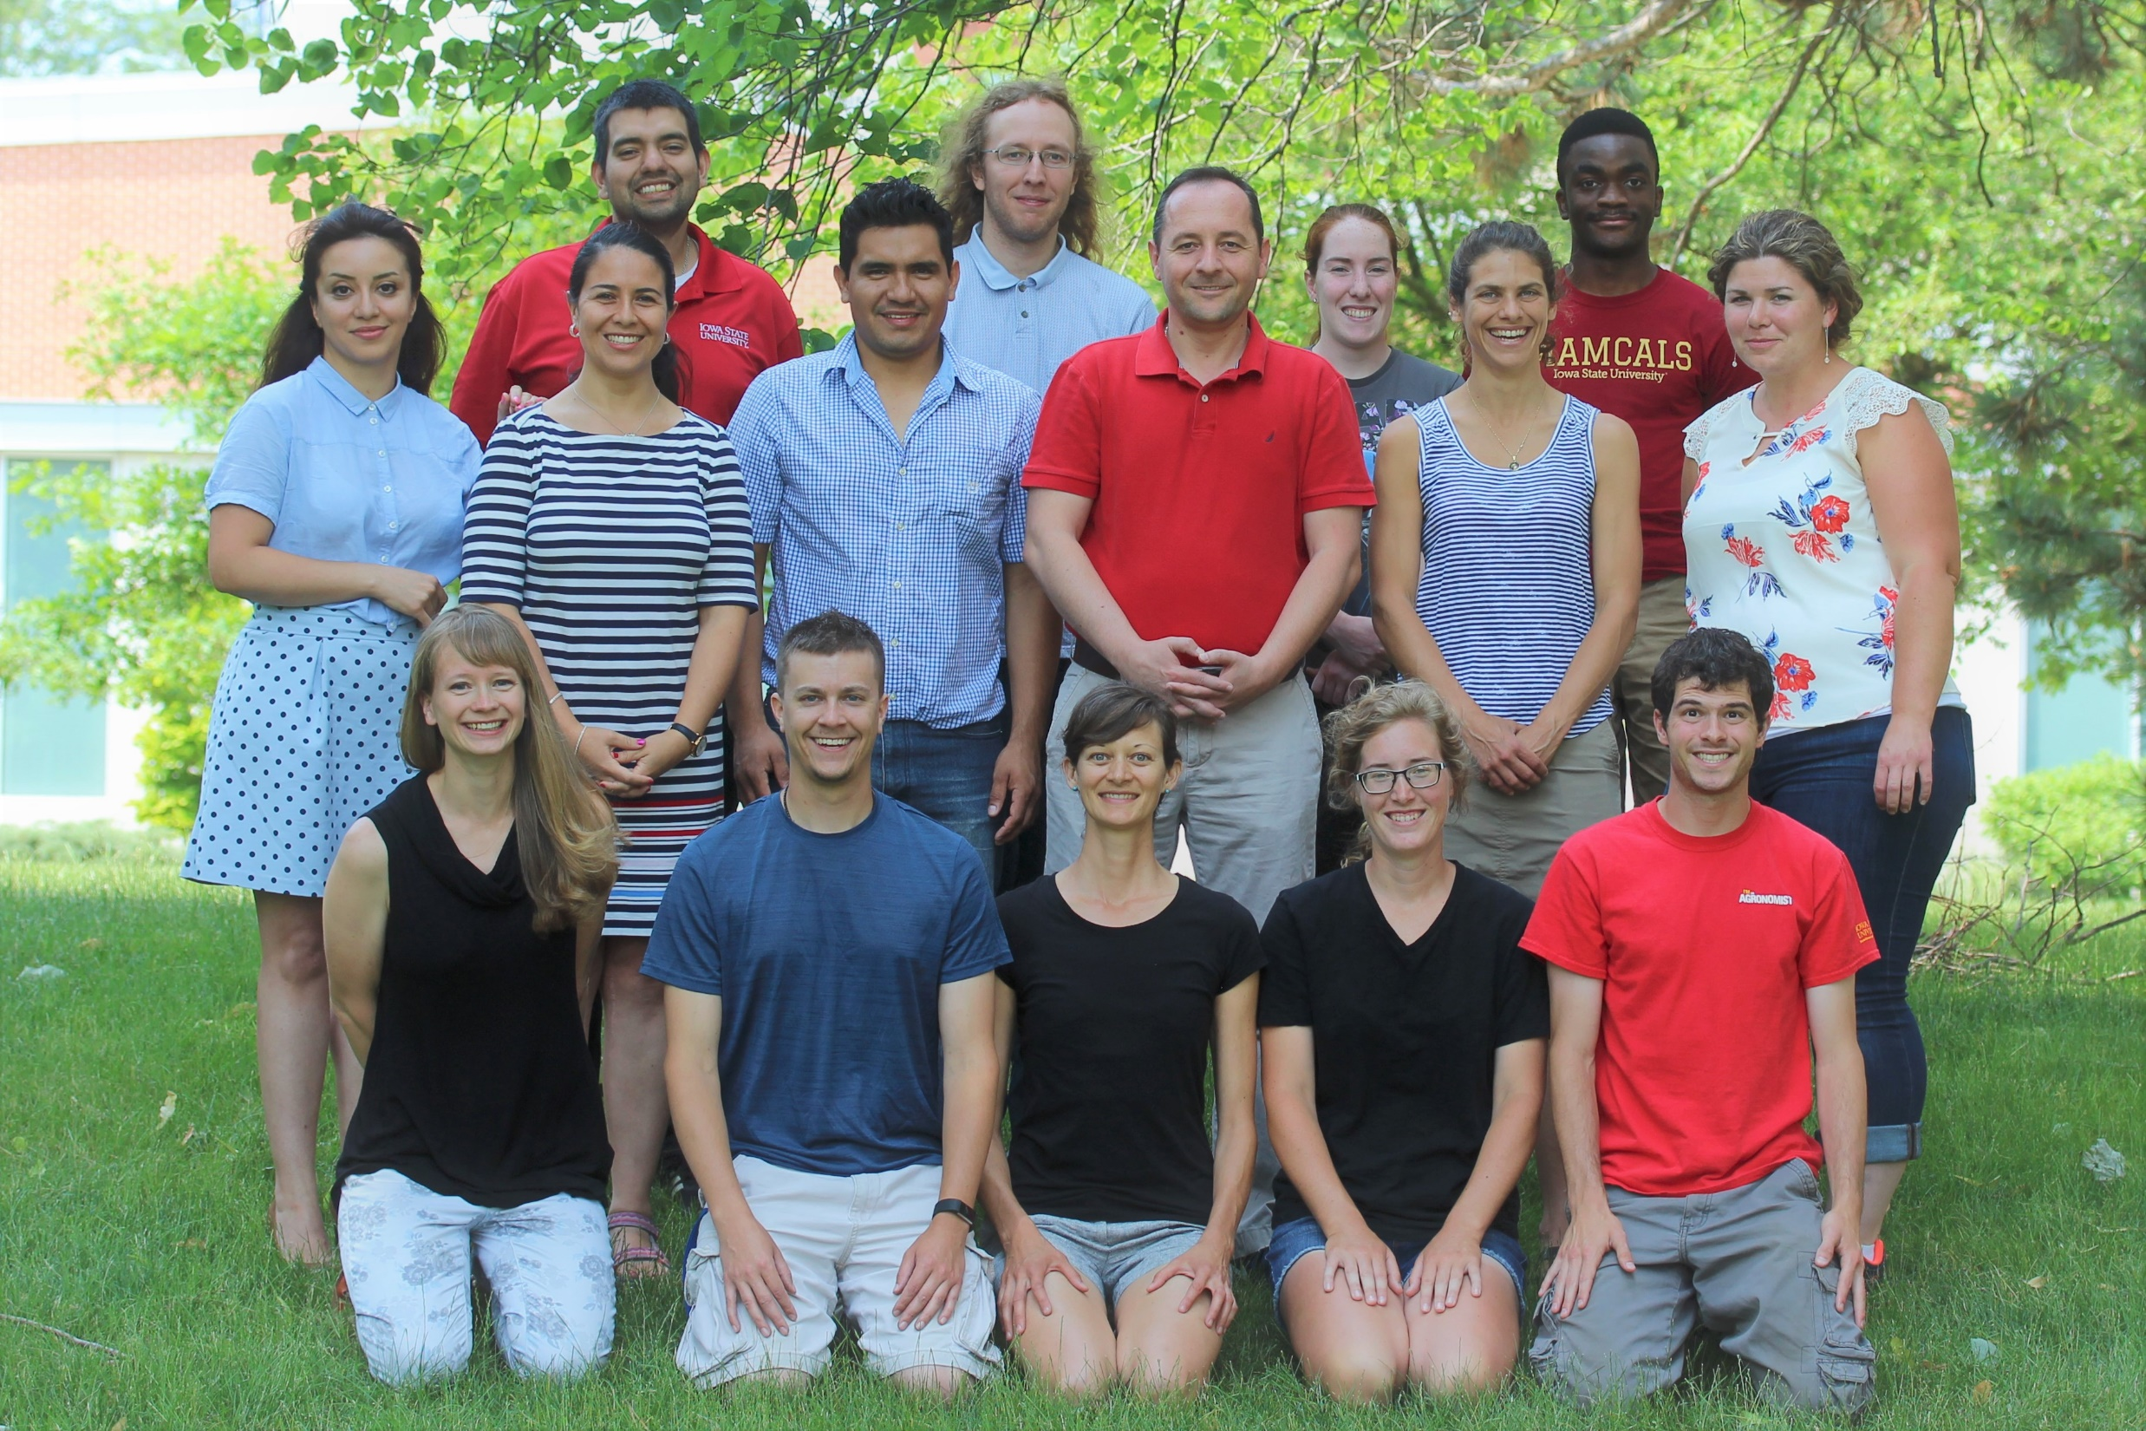

Slide 74
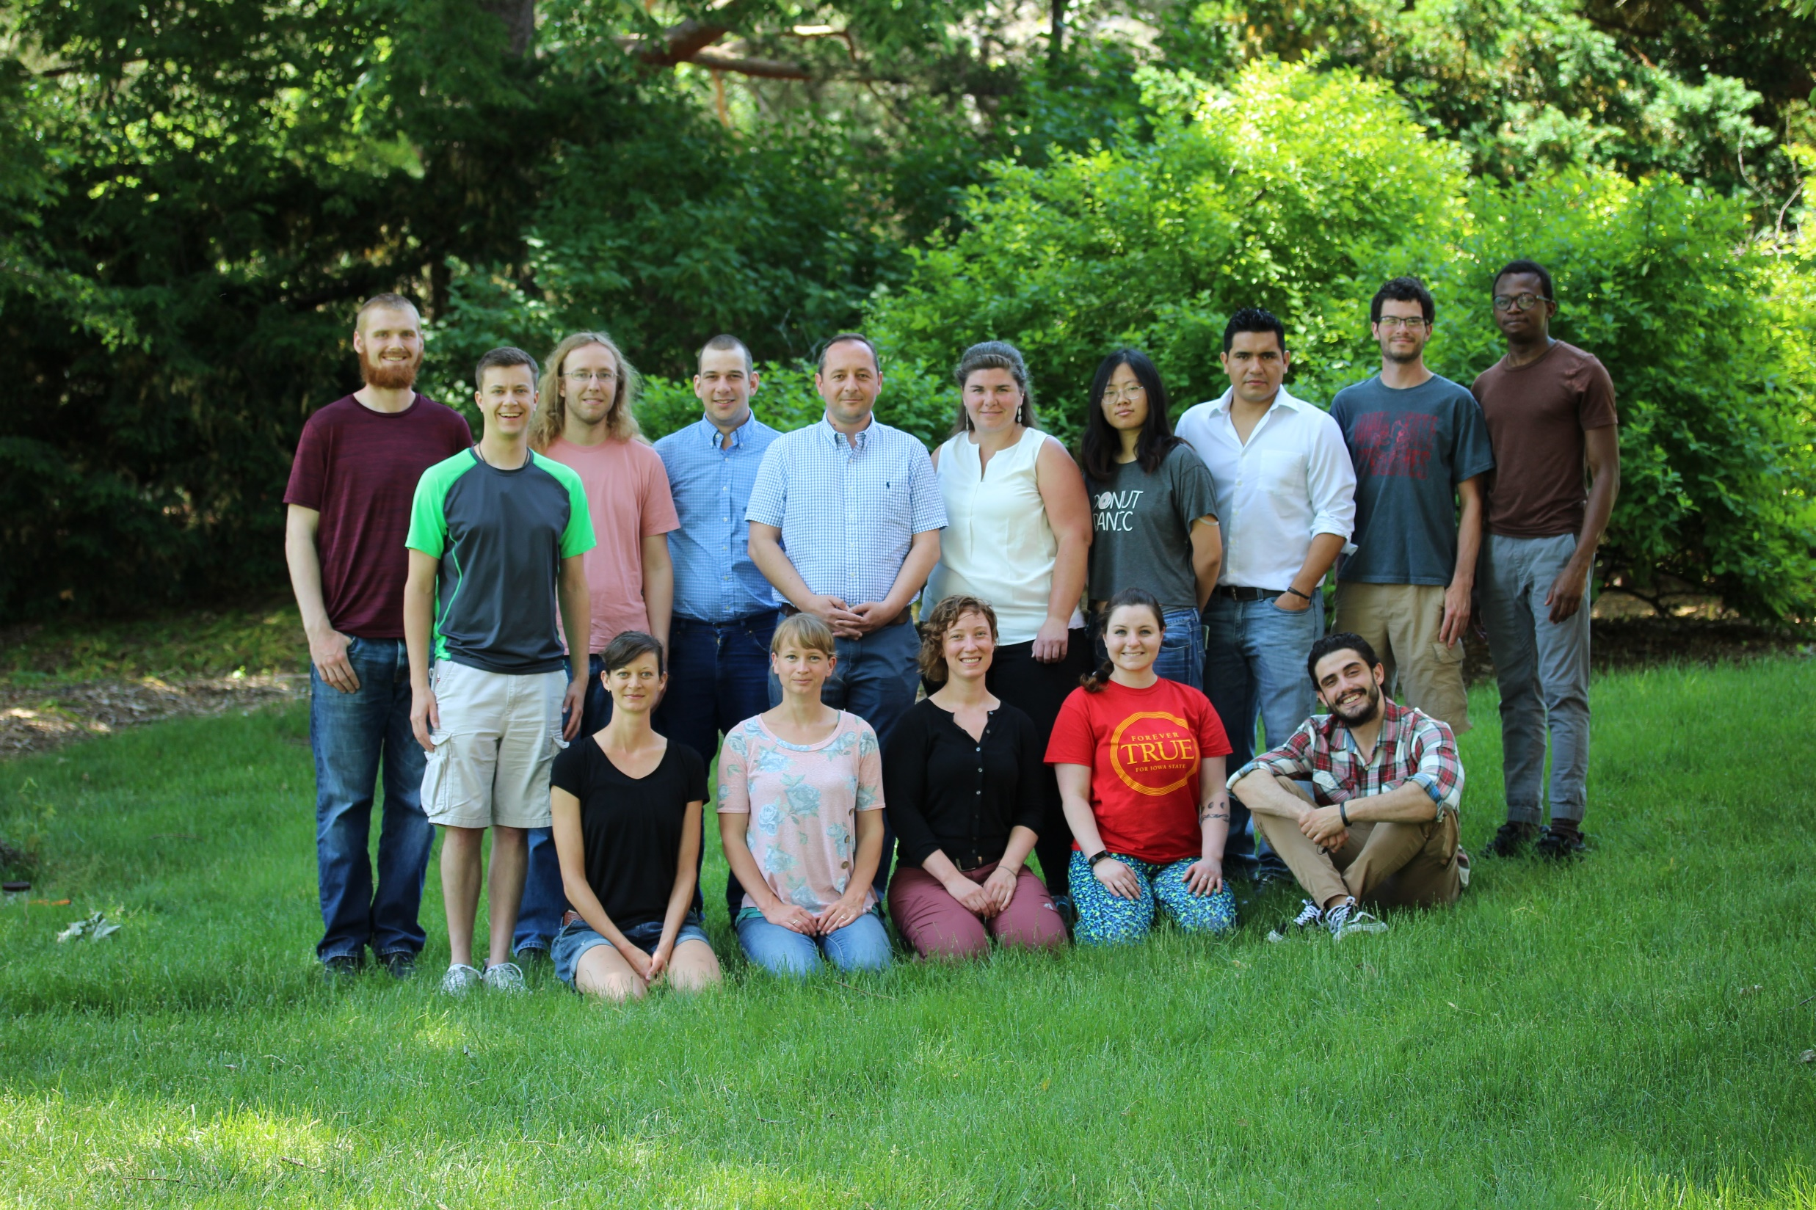

Slide 75
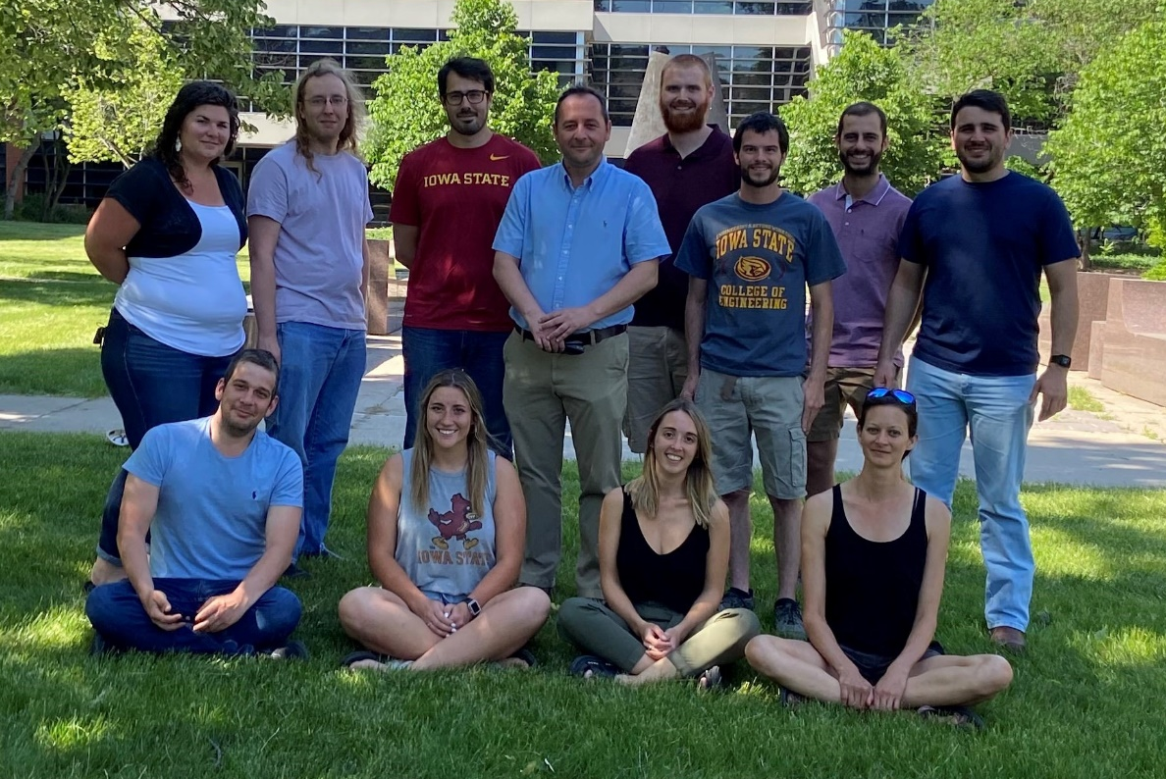

Slide 76
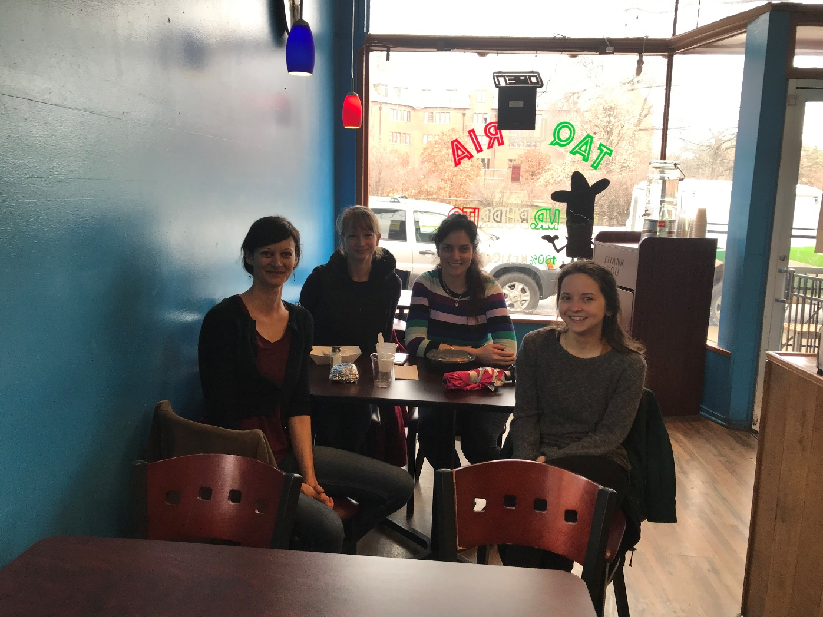
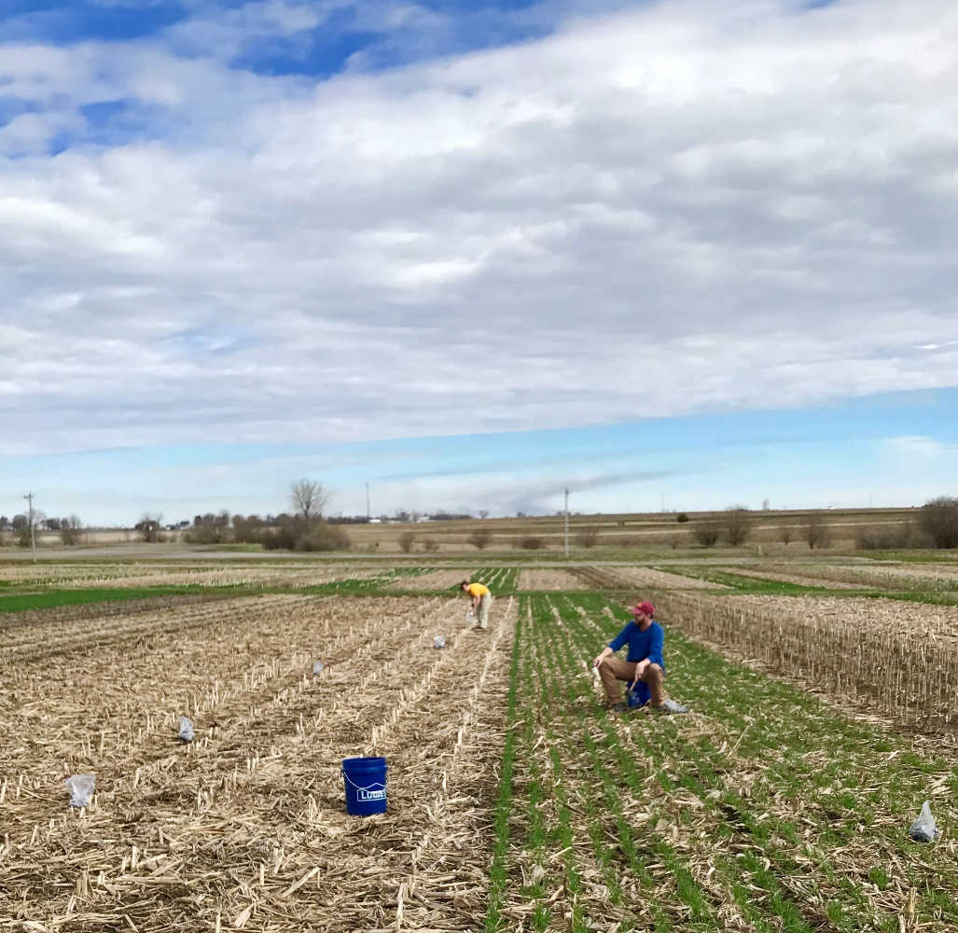
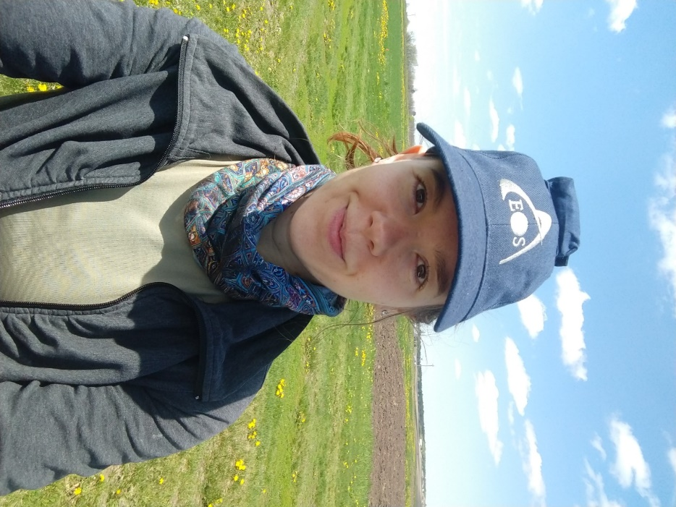

Slide 77



DataFEWSion Traineeship
Henry A. Wallace Chair for Sustainable Agriculture

Slide 78
Extras

Slide 79
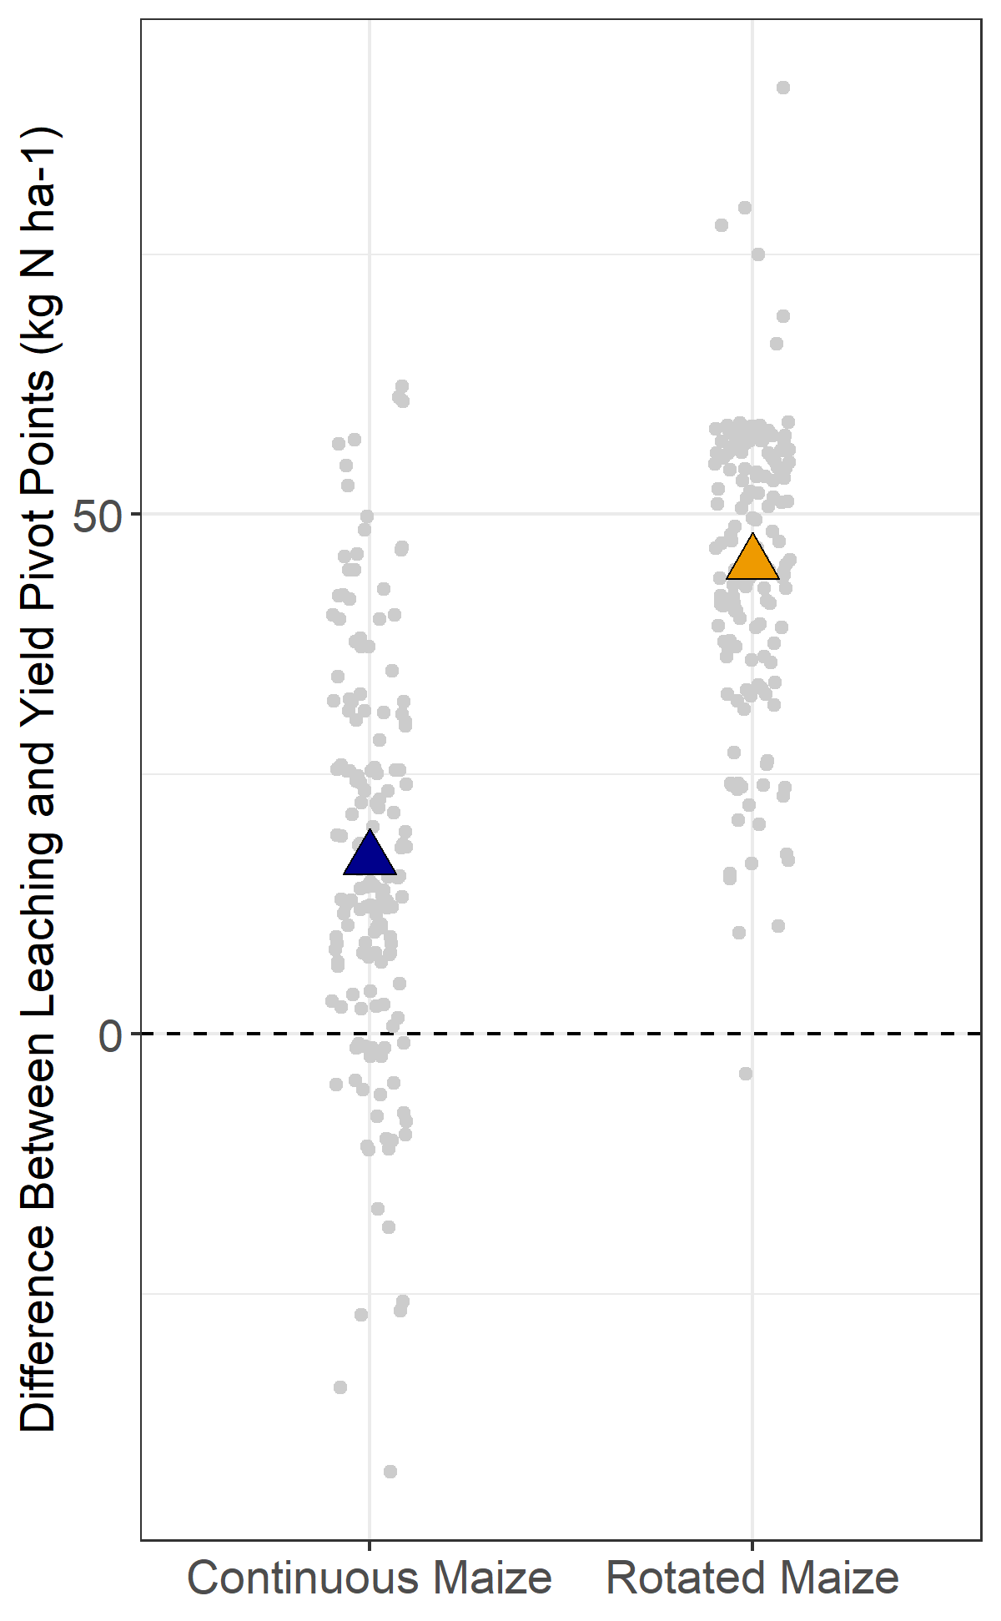

Slide 81
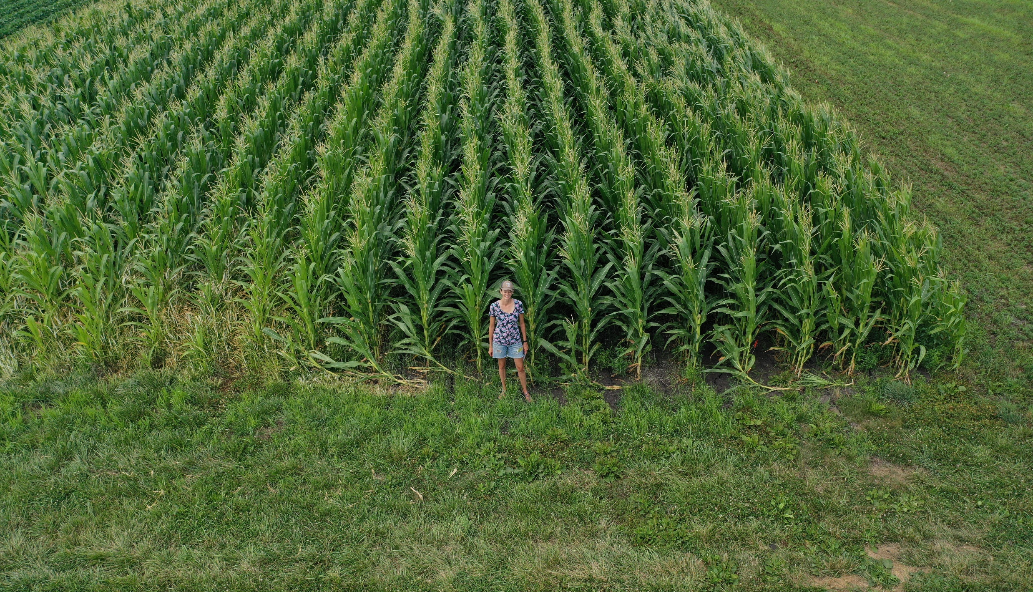

Slide 82



Slide 83

8 sites, 151 site-years, modeled nitrate leaching at 150 and 200 kg N application

Slide 84

Example of undetermined penalty

Slide 85


